Slide 1
Liquid/Semiconductor Interfaces through Vibrational Spectroscopy
R. Kramer Campen
Physical Chemistry Department
Fritz Haber Institute of the Max Planck Society
w/ Maria Sovago, Cho-Shuen Hsieh, Mischa Bonn, Ana Vila Verde
25/3/13
1 / 37

Slide 2
Outline
Justification: why vibrational spectrocopy?
Background: making vibrational spectroscopy interface specific: vibrational sum frequency spectroscopy
Interfacial Solvent (Water): structure and dynamics
Semiconductor Interface: optical detection of surface phonons
Outline
25/3/13
2 / 37

Slide 3
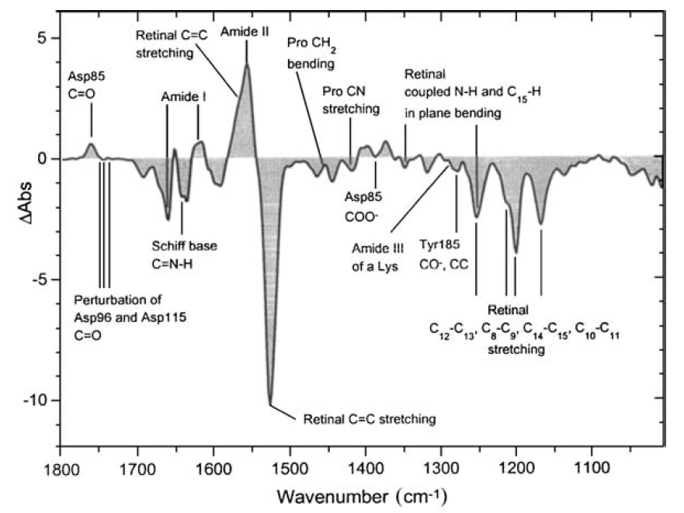
Why vibrational spectroscopy?
Vibrations report, label free, on inter/intramolecular forces (and structure)
Macromolecules (proteins)
Spectrum of local oscillators modified by environment,
Through-bond coupling
Hydrogen bonding
Transition dipole coupling
Barth and Zscherp (2002) Quarterly Reviews of Biophysics, 35, 4
from
Zscherp and Heberle (1997) Journal of Physical Chemistry B, 101, 10542
I. Justification
25/3/13
3 / 37

Slide 4
Why vibrational spectroscopy?
Vibrations report, label free, on interatomic/molecular forces (and structure)
Liquids (water)
OH stretch modulated by anharmonic coupling to low frequency modes.
I. Justification
25/3/13
4 / 37

Slide 5
Interface specific vibrational spectroscopy
Vibrational Sum Frequency Spectroscopy
ir
vis
sfg
χ⁽²⁾=0
χ⁽²⁾=0
ν=1
forbidden in bulk water
ν=0
II. Background
25/3/13
5 / 37

Slide 6
What is detected?
The field radiated by the second order induced polarization
Induced polarization can be expanded in a Taylor series
Assuming two incident plane waves and just considering the second order term,
II. Background
25/3/13
6 / 37
Notes:
P \; \propto \; \chi^{(1)}E + \chi^{(2)}E^{2} + \chi^{(3)}E^{3}+ \ldots
P^{(2)} \; \propto \; \chi^{(2)}\left( E_{1}\cos \omega_{1}t + E_{2}\cos\omega_{2}t \right)^2
E_{1}^{2} + E_{2}^{2}
E_{1}^{2}\cos2\omega_{1}t + E_{2}^{2}\cos2\omega_{2}t
\frac{1}{2}E_{1}E_{2}\cos\left(\omega_{1} - \omega_{2} \right)t

Slide 7
Origin of Interfacial Specificity
Even order nonlinear susceptibilities
Second order nonlinear susceptibilities are third rank tensors
…
Changing the sign of all indices is equivalent to inverting the axes: the material response must change sign…
But, with inversion symmetry, all directions are equivalent so…
For materials with inversion symmetry (χ⁽²⁾=0), inversion symmetry is always broken at interfaces.
II. Background
25/3/13
7 / 37

Slide 8
Origin of Chemical Specificity
Raman scattering off an excited, coherent, vibration
VSF active modes must be Raman and IR active.
II. Background
25/3/13
8 / 37
Notes:
\chi^{(2)}_{ijk} \; = \; N \sum_{i^{\prime}j^{\prime}k^{\prime}} \langle R_{ii^{\prime}}R_{jj^{\prime}}R_{kk^{\prime}} \rangle \beta^{(2)}_{i^{\prime}j^{\prime}k^{\prime}}

Slide 9
III. Approaching the Interface from the Solvent Side: Interfacial Water Structure
III. Solvent to Interface: Structure
25/3/13
9 / 37

Slide 10
The OH stretch at the air/water interface
Two (or three) qualitative populations
free
0.6
Hydrogen Bonded OH
0.5
Free OH
0.4
I_{SFG} (arbitrary units)
0.3
0.2
0.1
IR Abs: Liquid Water
0.0
VSF spectral features are apparent that are absent in bulk IR.
3000
3200
3400
3600
3800
IR frequency (cm⁻¹)
III. Solvent to Interface: Structure
25/3/13
10 / 37

Slide 11
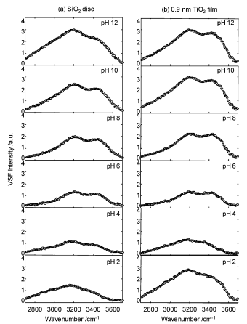
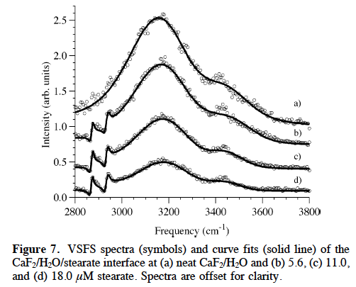
Is the double peaked feature general?
Yes!
Double peaked feature appears at all interfaces
Becraft and Richmond (2005) Journal of Physical Chemistry B, 109(11), 5108
Kataoka,…, Cremer (2004) Langmuir, 20(5), 1662
III. Solvent to Interface: Structure
25/3/13
11 / 37

Slide 12
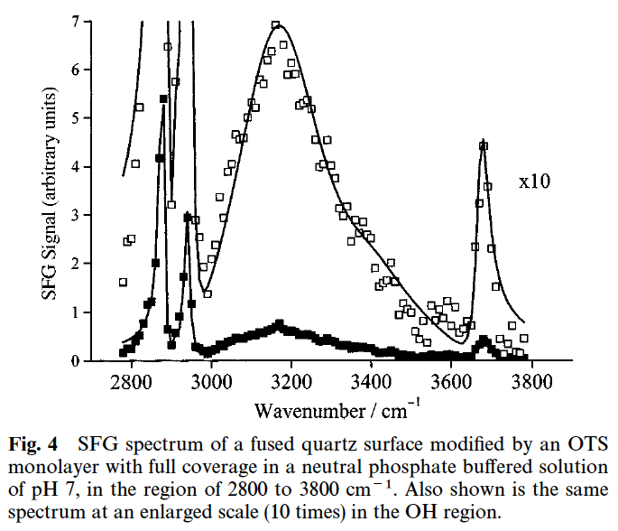
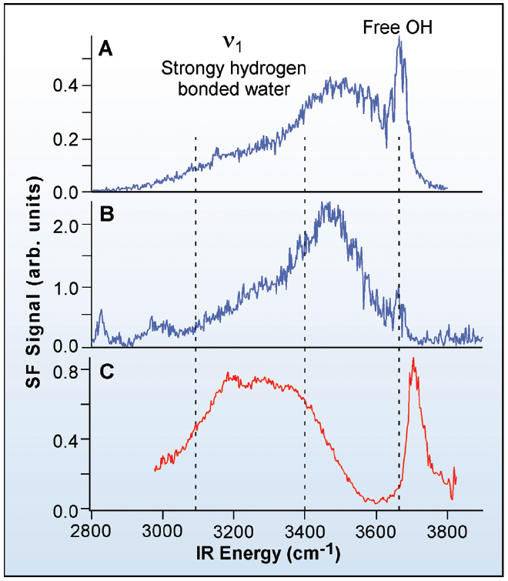
Is the free OH feature general?
It appears at all hydrophobic interfaces
Silica/OTS/Water Interface
CCl₄ / H₂O
Hexane / H₂O
Air/ H₂O
Ye, Nihonyanagi, Uosaki (2001) PCCP, 3(16), 3463
Scatena, Brown, Richmond (2001) Science, 292, 908
III. Solvent to Interface: Structure
25/3/13
12 / 37

Slide 13
What causes the double peaked feature ?
One idea: interfacial structural heterogeneity
strong ‘ice-like’
weak ‘water-like’
0.6
0.5
0.4
0.3
I_{SFG}
0.2
ice
0.1
liquid water
0.0
3000
3200
3400
3600
3800
IR frequency (cm⁻¹)
Du,…, Shen(1993) Physical Review Letters, 70(15), 2313
III. Solvent to Interface: Structure
25/3/13
13 / 37

Slide 14
What causes the double peaked feature ?
A second idea: symmetric/asymmetric stretch
asym
O-D
O-D
symm
(same water molecule)
III. Solvent to Interface: Structure
25/3/13
14 / 37

Slide 15
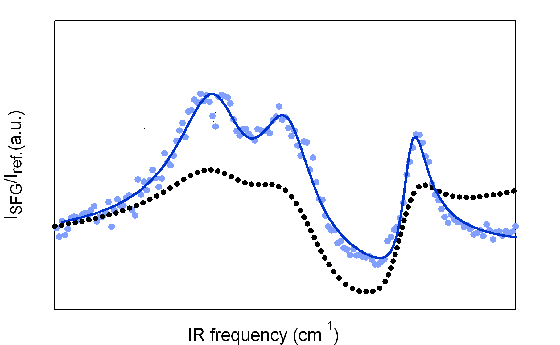
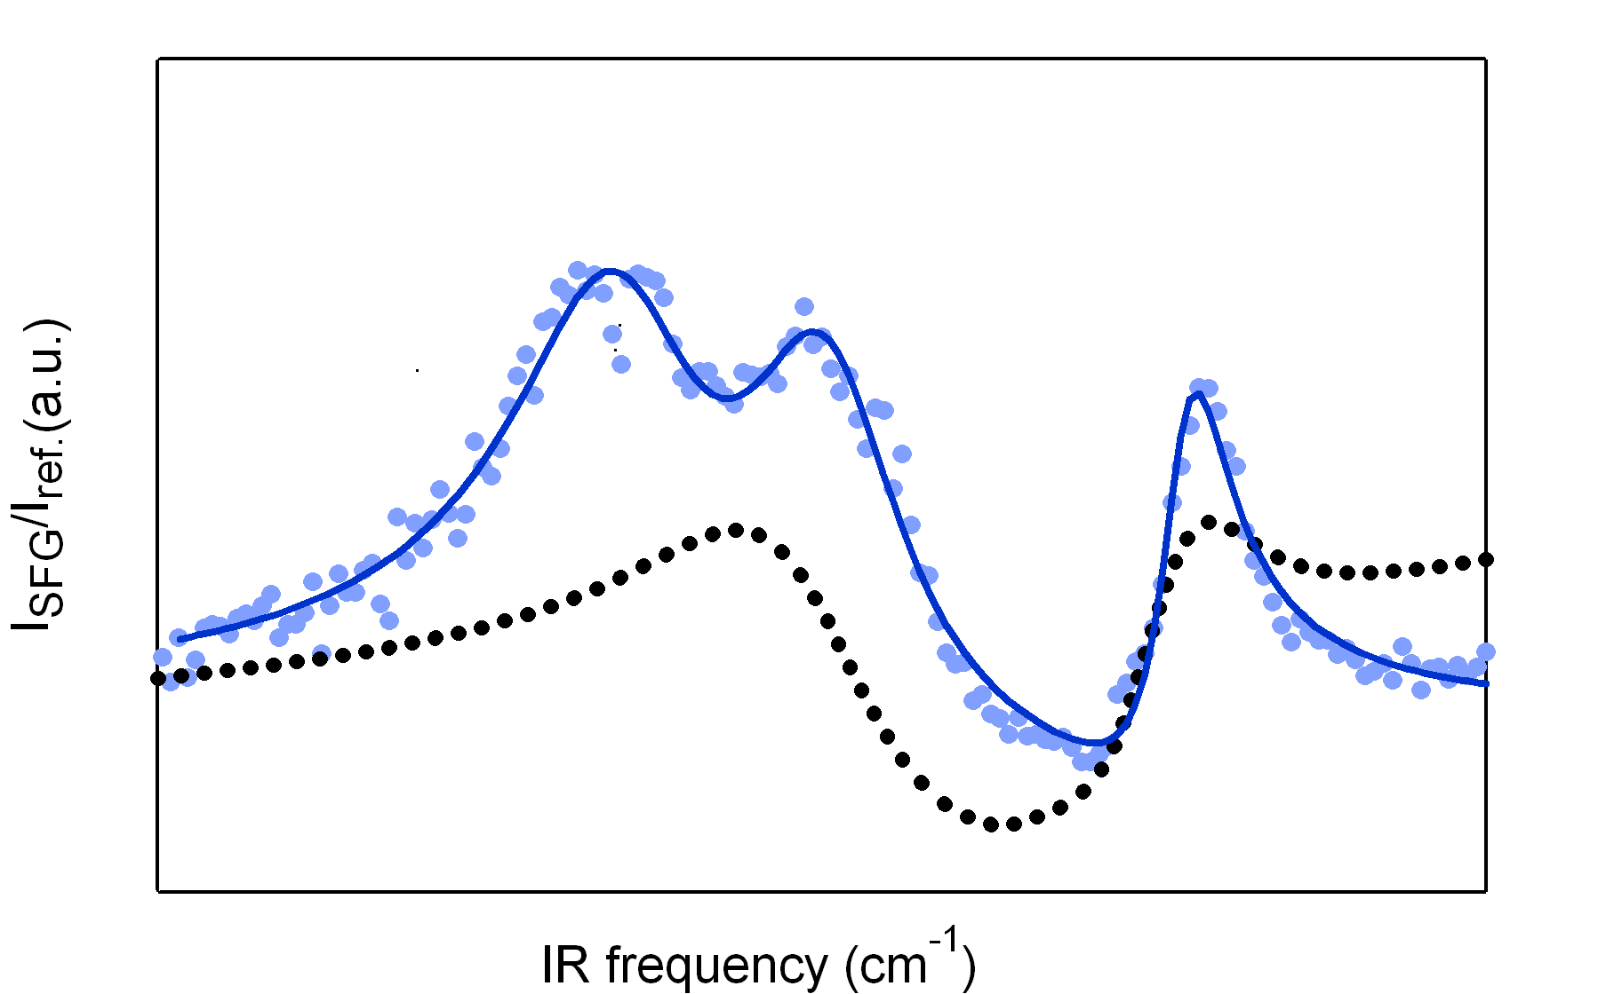
How can we distinguish these scenarios experimentally
Isotopic dilution
‘Ice/Liquid-like’ hypothesis
Sym/Asym hypothesis
Strong
SS
Weak
AS
D₂O
D₂O
HDO
HDO
SS
AS
The amplitude of the whole spectrum should change.
Two peaks should collapse to one
III. Solvent to Interface: Structure
25/3/13
15 / 37

Slide 16
Two peaks collapse to one
double peaked spectral feature ≠ water structure
2
O-D
water /
C-H
lipid ÷10
pure D₂O
SFG intensity (arb. units)
1
H₂O:D₂O 2:1
water/air
pure D₂O
H₂O:D₂O 2:1
0
2000
2200
2400
2600
2800
3000
3200
IR frequency (cm⁻¹)
III. Solvent to Interface: Structure
25/3/13
16 / 37

Slide 17
Are the two peaks sym/asym?
bend overtone (δ_{OH}=2)
Two peaks have same symmetry!#
*
*
water/air
2000
2200
2400
2600
2800
3000
IR frequency (cm⁻¹)
asym
H
O-D
*
O-D
symm
δ_{OH}=2
D
*
D₂O → HOD switches off coupling
# Gan,…, Wang (2006) Journal of Chemical Physics, 124, 114705.
III. Solvent to Interface: Structure
25/3/13
17 / 37

Slide 18
Hypothesis one: two peaks are from a Fermi Resonance with the Bend Overtone
bend overtone (δ_{OH}=2)
*
*
water/air
2000
2200
2400
2600
2800
3000
IR frequency (cm⁻¹)
stretch mode DOS
frequency
bend overtone (δ_{OH}=2)
coupling off
Evans window
coupling on
III. Solvent to Interface: Structure
25/3/13
18 / 37

Slide 19
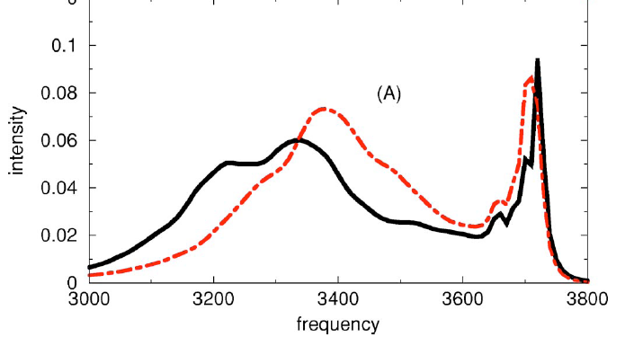
Hypothesis two: low frequency peak from collective effects (intermolecular coupling)
coupling switched off
Buch et al. (2007) Journal of Chemical Physics, 127(20), 204710
Computation suggests the low frequency peak is a the result of intermolecular coupling (vibrational delocalization).
III. Solvent to Interface: Structure
25/3/13
19 / 37

Slide 20
In either case using HDO allows more straightforward access to structure
Fitting the HDO data
III. Solvent to Interface: Structure
25/3/13
20 / 37

Slide 21
III. Solvent to Interface: Dynamics
free
0.6
Free OH
0.5
0.4
I_{SFG} (arbitrary units)
0.3
0.2
0.1
IR Abs: Liquid Water
0.0
3000
3200
3400
3600
3800
IR frequency (cm⁻¹)
III. Solvent to Interface: Dynamics
25/3/13
21 / 37

Slide 22
Probing dynamics: IR pump – VSF Probe
IR pump (100 fs)
IR (100 fs)
pump
SFG
SFG
vis (100 fs)
τ_{wait}
SFG signal decreases due to depletion of ground state.
Recovery reflects vibrational relaxation and possibly reorientation.
v = 1
τ_{wait}
v = 0
III. Solvent to Interface: Dynamics
25/3/13
22 / 37

Slide 23
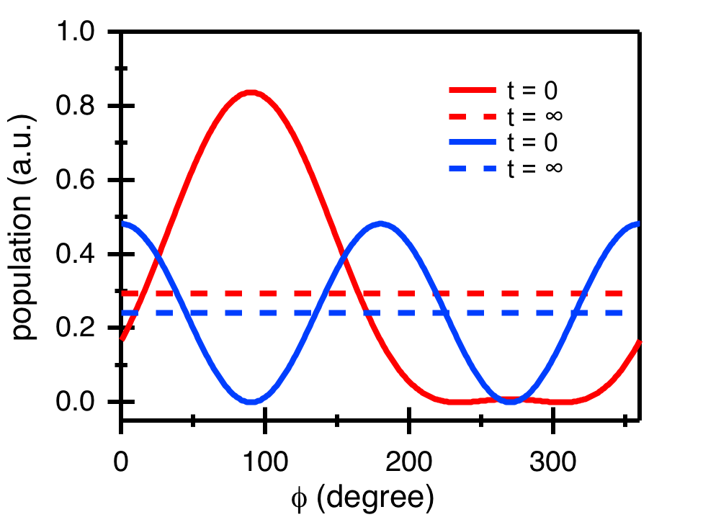
Probing reorientation of the free OH
III. Solvent to Interface: Dynamics
25/3/13
23 / 37

Slide 24
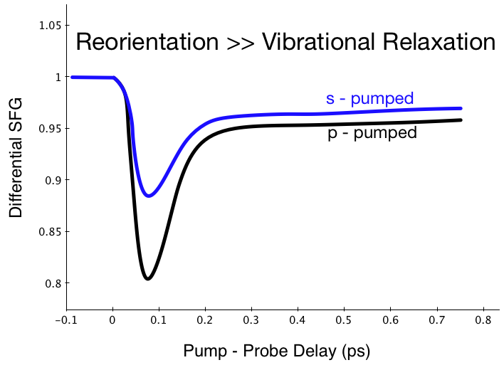
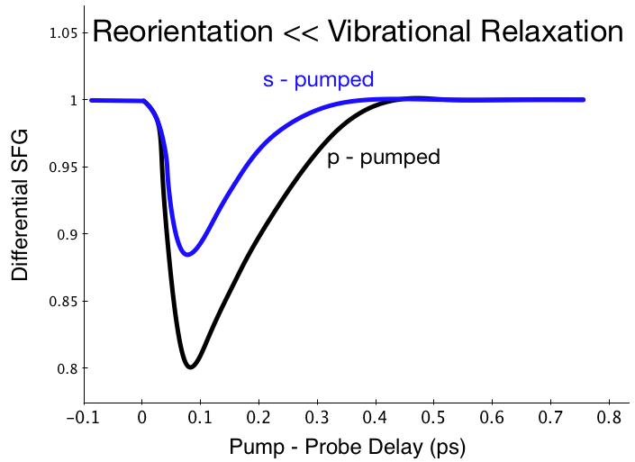
Developing intuition for the signal
Signals relax at…
different rates
the same rate
At long times…
signals do not converge
signals converge
III. Solvent to Interface: Dynamics
25/3/13
24 / 37

Slide 25
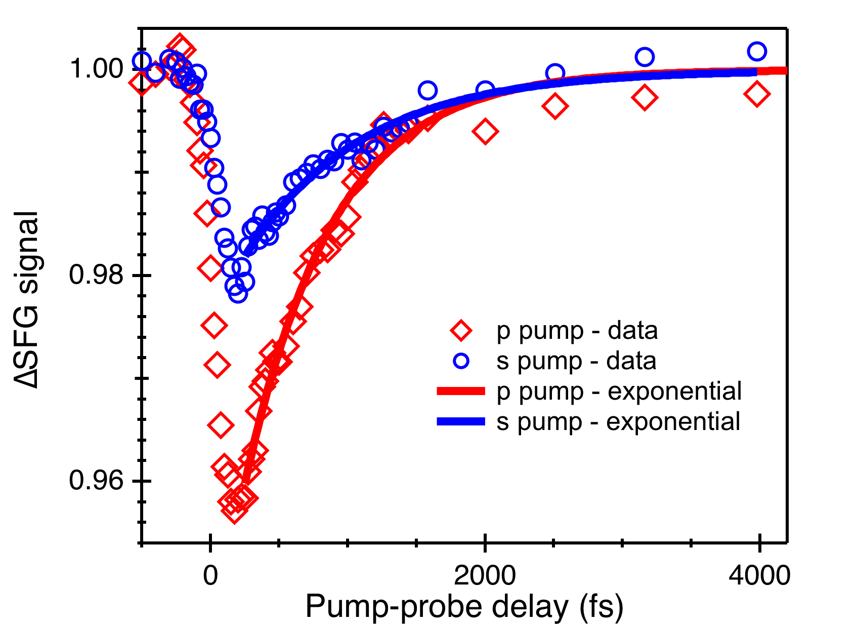
Free OH relaxation is intermediate
τ_{p, pump} = 640 ± 20 fs
τ_{s. pump} = 870 ± 50 fs
III. Solvent to Interface: Dynamics
25/3/13
25 / 37

Slide 26
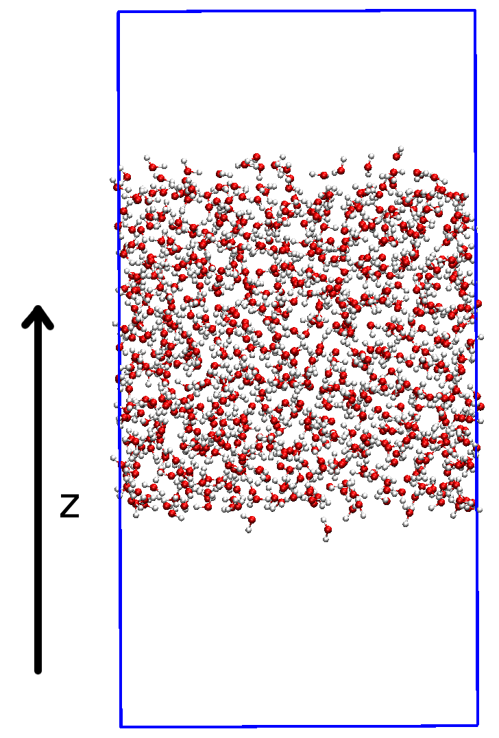
A brief simulation interlude
Simulation box is 30*30*60 Å.
Periodic boundary conditions.
NVE at T = 300 K.
Simulation run for 2 ns (step = 1 fs).
SPC/E potential.
III. Solvent to Interface: Dynamics
25/3/13
26 / 37

Slide 27
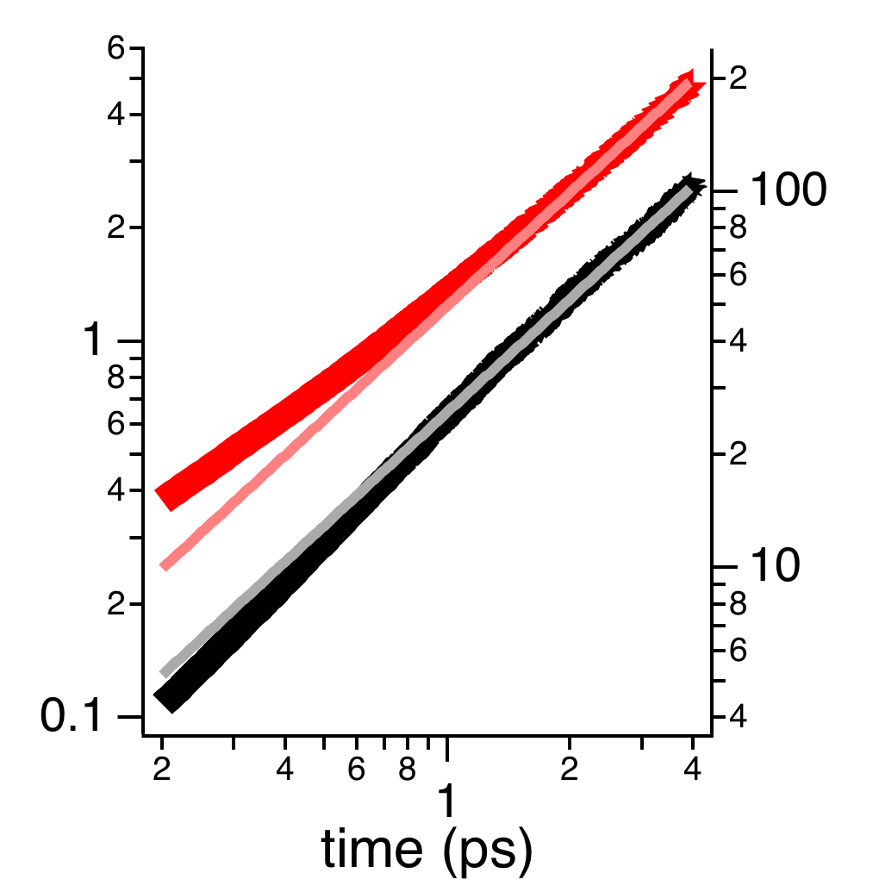
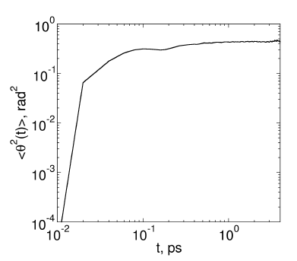
Free OH reorientation is diffusive (in MD)
bulk H₂O
〈ω²〉
〈ϕ²〉
free OH
= yes
θ = maybe (diffusion within a potential)
III. Solvent to Interface: Dynamics
25/3/13
27 / 37

Slide 28
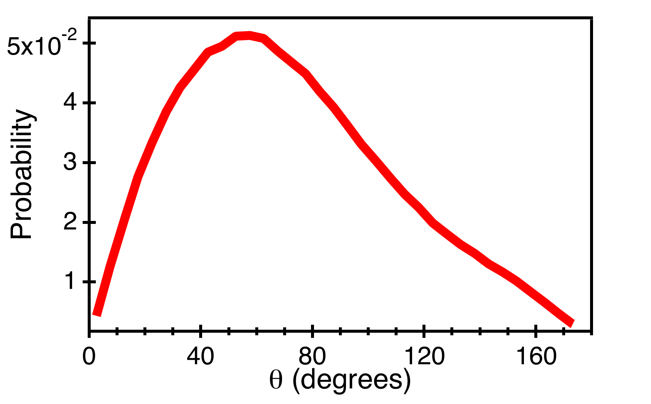
Free OH has a preferred distribution in θ
Consistent with diffusion in a potential
III. Solvent to Interface: Dynamics
25/3/13
28 / 37

Slide 29
Model reorientation as diffusive in a potential
III. Solvent to Interface: Dynamics
25/3/13
29 / 37

Slide 30
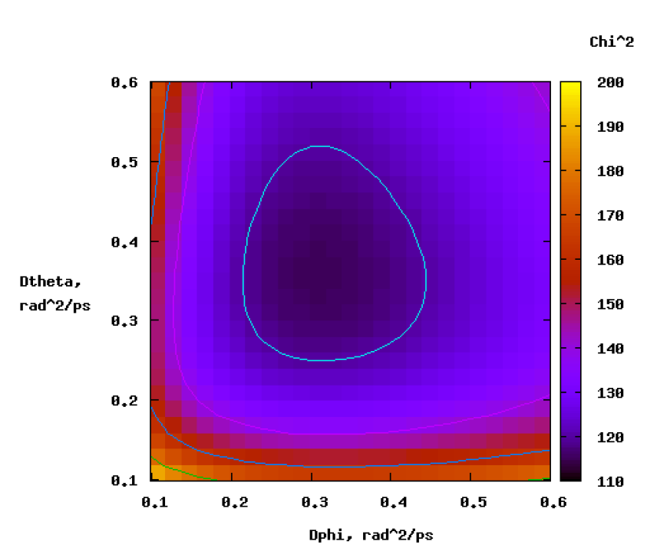
Fitting 2D diffusion model to simulation output
D_{φ} = 0.32 rad²/ps, D_{θ} = 0.36 rad²/ps
III. Solvent to Interface: Dynamics
25/3/13
30 / 37

Slide 31
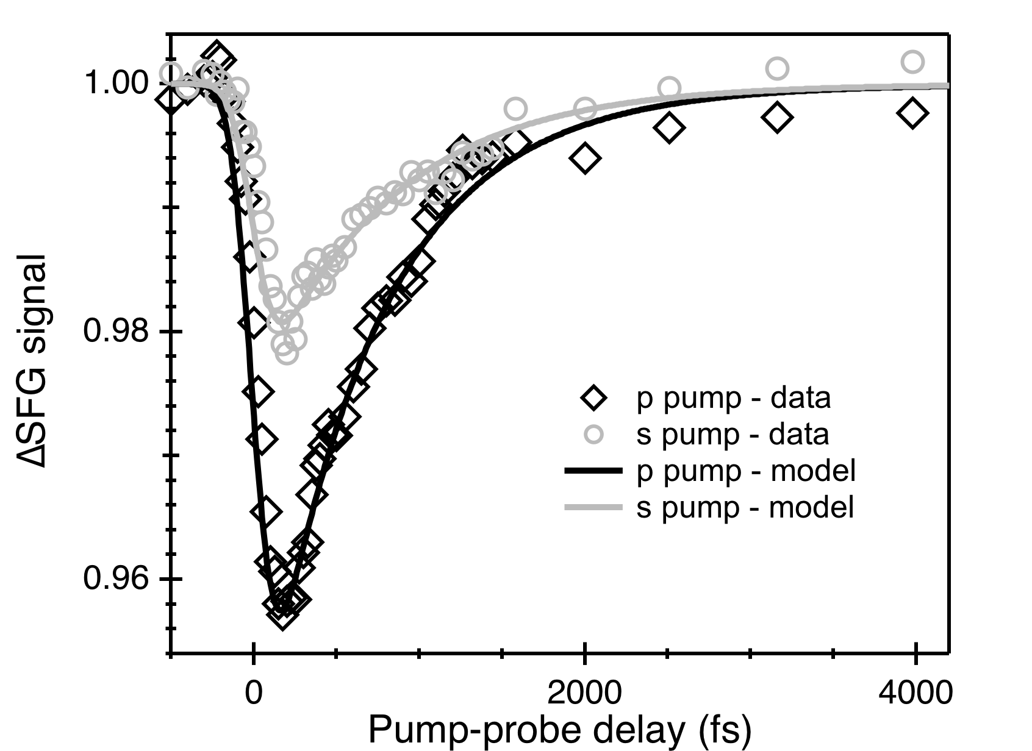
MD results describe data without adjustable parameters
III. Solvent to Interface: Dynamics
25/3/13
31 / 37

Slide 32
Free OH reorientation relative to bulk
Bulk (arb orient)
D_{ϕ} = 0.1 rad²/ps
D_{θ} = 0.1 rad²/ps
Free OH
D_{ϕ} = 0.32 rad²/ps
D_{θ} = 0.36 rad²/ps
On average, free OH reorient ≈ 3x faster than bulk
III. Solvent to Interface: Dynamics
25/3/13
32 / 37

Slide 33
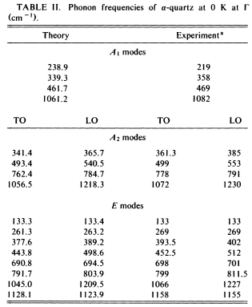
Phonon spectroscopy in bulk α-qtz
Probing these modes optically (IR or Raman) depends on:
Mode symmetry
Tranverse (couples to IR) v. longitudinal (does not)
Gonze, Allan, Teter (1992) Physical Review Letters, 68(24), 3603
IV. Solid to Interface
25/3/13
33 / 37

Slide 34
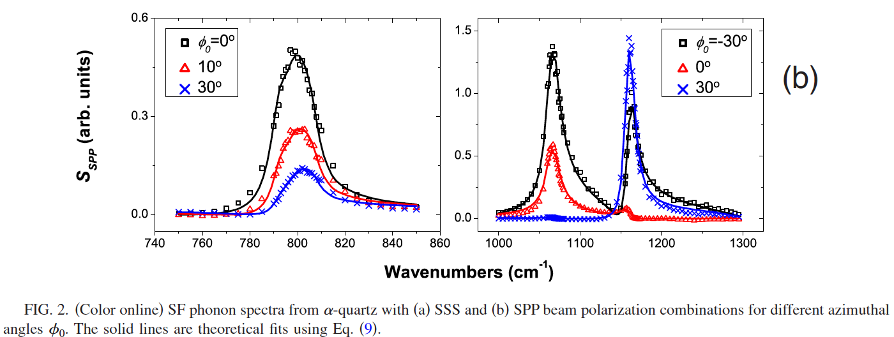
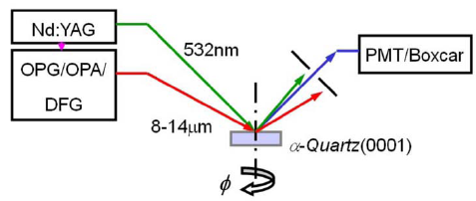
VSF phonon spectroscopy in bulk α-qtz
795 cm⁻¹
1064 cm⁻¹
1160 cm⁻¹
Liu and Shen (2008) Physical Review B, 78(2), 024302
VSF probes both IR and Raman active transverse optical phonons: a simplified phonon spectrum that reflects bulk symmetry.
IV. Solid to Interface
25/3/13
34 / 37

Slide 35
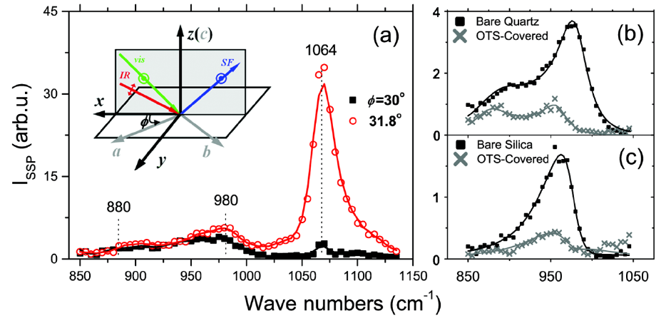
VSF surface phonon spectroscopy on α-qtz and amorphous SiO₂
Liu and Shen (2008) Physical Review Letters, 101(1), 016101
Resonances appear in VSF response at,
nonbulk frequencies
nonbulk symmetries
for amorphous material
and are perturbed by surface chemistry
IV. Solid to Interface
25/3/13
35 / 37

Slide 36
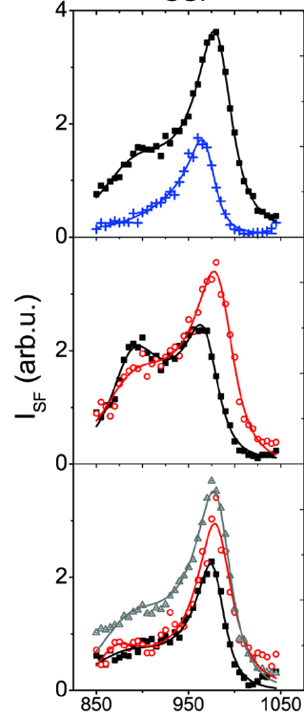
VSF surface phonon spectroscopy on α-qtz for tracking surface reconstruction
Liu and Shen (2008) Physical Review Letters, 101(1), 016101
O
OH
Si
Si
Si
= quartz
+
= amorphous silica
rehydroxylated in ambient air
OH
2
O
+
H₂O
after being baked at 100°C
Si
Si
Si
rehydroxylated in boiling water
rehydroxylated in ambient air
surface damage
after being baked at 500°C
wavenumber (cm⁻¹)
IV. Solid to Interface
25/3/13
36 / 37

Slide 37
Conclusions
Using VSF spectroscopy one can probe both interfacial solvent (most work on water) and surface phonons at buried interfaces.
Adding additional pulses to VSF experiments makes it possible to probe structural and energy relaxation dynamics with interfacial specificity.
Future work: optically probing the association of interfacial molecules with particular surface sites.
Conclusions
25/3/13
37 / 37

Slide 38
Related Publications (from our previous work the results of which were discussed above)
Sovago, Campen, Wurpel, Müller, Bakker, Bonn (2008) Vibrational Response of Hydrogen-Bonded Interfacial Water is Dominated by Interfacial Coupling, Physical Review Letters, 100, 173901
Sovago, Campen, Bakker, Bonn (2009) Hydrogen bonding strength of interfacial water determined with surface sum-frequency generation, Chemical Physics Letters, 470, 7
Hsieh, Campen, Vila Verde, Bolhuis, Nienhuys, Bonn (2011) Ultrafast Reorientation of Dangling OH Groups at the Air-Water Interface Using Femtosecond Vibrational Spectroscopy, Physical Review Letters, 107(11), 116102
Vila Verde, Bolhuis, Campen (2012) Statics and Dynamics of Free and Hydrogen-Bonded OH Groups at the Air/Water Interface, Journal of Physical Chemistry B, 116(31), 9467
25/3/13
bonus page

