Slide 1
Plasmons from 3D to 1D

Slide 2
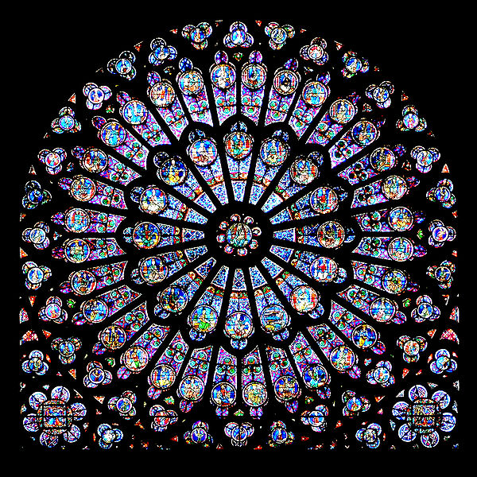
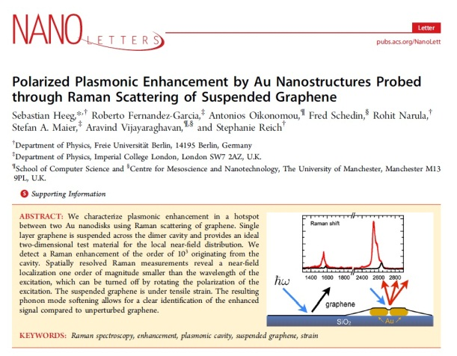
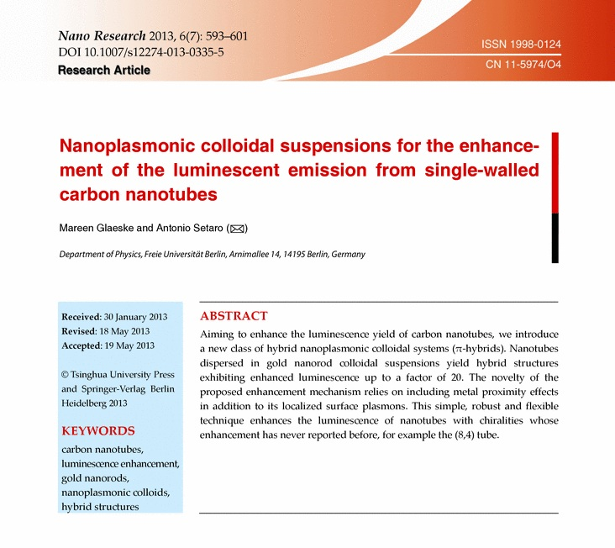
Motivation
Stained glass rose window
Notre Dame de Paris

Slide 3
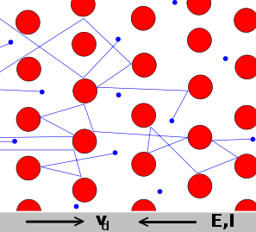
Drude-Lorentz-Model
Valence electrons of metals can be described as a free electron gas
Damping ɣ is explained through collisions with the nuclei which are fixed

Slide 4
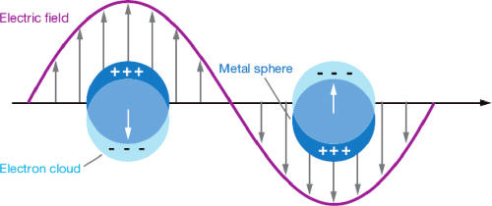
Dielectric function and plasma frequency
The angular frequency of the electron density oscillating around the average density is called plasma frequency $ω_{p}$
The dielectric function depends on the angular frequency
$ε_{r}\left(ω\right)=1−\frac{ω_{p}^{2}}{ω^{2}}$
for most metals $ω_{p}^{}$ is
in the ultraviolet region

Slide 5
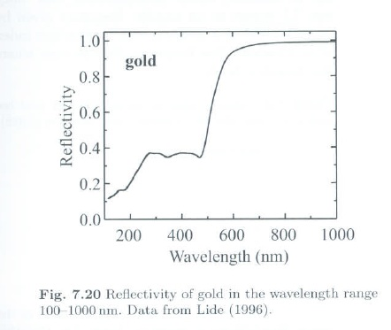
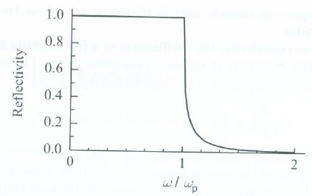
Reflectivity
R= |$\frac{ñ−1}{ñ+1}$|² with $ñ=\sqrt{ε_{r}\left(ω\right)}$
R is 1 for ω ≤$ω_{p}$
decreasing for ω >$ω_{p}$
0 for ω = ∞

Slide 6
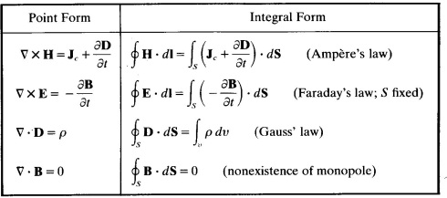
Maxwell‘s equations

Slide 7
Plasma oscillations
Equation can be split up in an transverse and longitudinal part
$\frac{{\text{∂}}^{2}{\vec{E}}_{t}}{\text{∂}t^{2}}+ω_{p}^{2}{\vec{E}}_{t}−c^{2}∆{\vec{E}}_{t}=0$ transverse part
$\frac{{\text{∂}}^{2}{\vec{E}}_{l}}{\text{∂}t^{2}}+ω_{p}^{2}{\vec{E}}_{l}=0$ longitudinal part
The longitudinal part corresponds to the harmonic oscillator

Slide 8
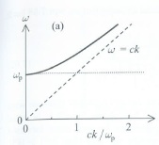
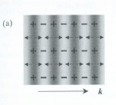
Plasma oscillations
Transverse solution
$c^{2}k^{2}=ω^{2}−ω_{p}^{2}$
Longitudinal solution
$$ω=ω_{p}^{}$$

Slide 9
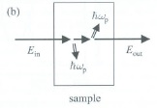
Plasmons
Light = transverse wave
Plasmon = longitudinal wave
=> plasmons can not be excited directly by light but by techniques of inelastic scattering
$E_{out}$ =${ E}_{in}$ - nħ$ω_{p}$

Slide 10
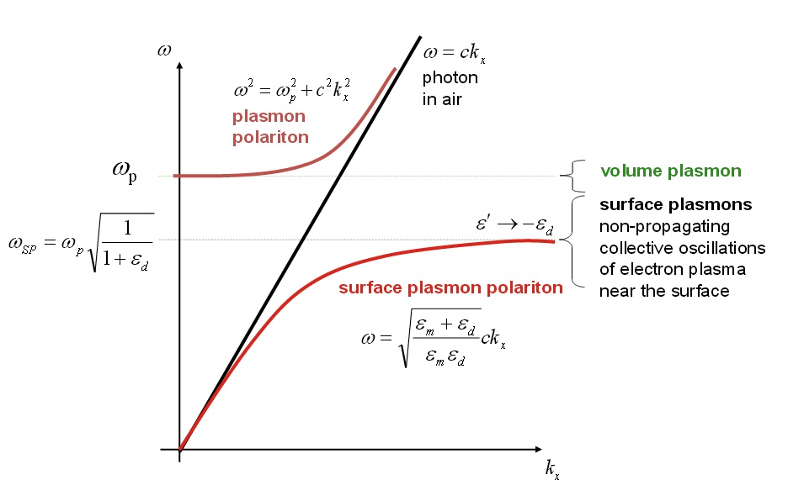
Surface Plasmons
Localized at the interface between a plasma and a dielectric
Have transversal and longitudinal electric field components

Slide 11
Thanks for your attention!

Slide 12
Sources
Optical Properties of Solids (Oxford Master Series in Physics) - Mark Fox
Principles of Optics: Electromagnetic Theory of Propagation, Interference and Diffraction of Light - M. Born, E. Wolf
Plasmonics: Fundamentals and Applications –Stefan Alexander Maier
http://webstaff.itn.liu.se/~alira/hjo_coe_seminar.ppt
http://web.pdx.edu/~larosaa/Applied_Optics_464-564/Lecture_Notes_Posted/2010_Lecture-7_SURFACE%20PLASMON%20POLARITONS%20AT%20%20METALINSULATOR%20INTERFACES/Lecture_on_the_Web_SURFACE-PLASMONS-POLARITONS.pdf

