Slide 1
Mathematical explanation for Surface Plasmon Polaritons
Benji Börner

Slide 2
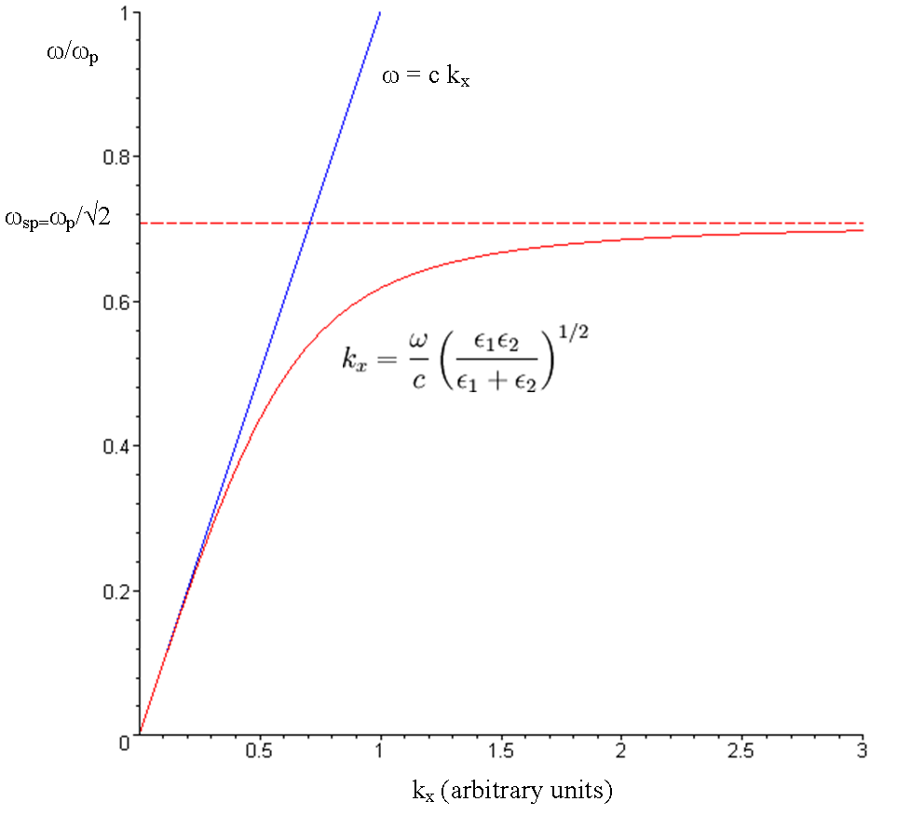
Revision of the problem
photon
SPP

Slide 3
Mathematical explanation bulk plasmon-polariton
Maxwell equation: $∇×\overline{H}=\overline{J}+j ωD$
$$ε\left(ω\right)=1−\frac{ω_{P}^{2}}{ω^{2}} with ω_{P}={\left(\frac{ne^{2}}{ε_{0}m^{∗}}\right)}^{\frac{1}{2}}$$
Wavenumber: $k^{2}=ω^{2}με$

Slide 4
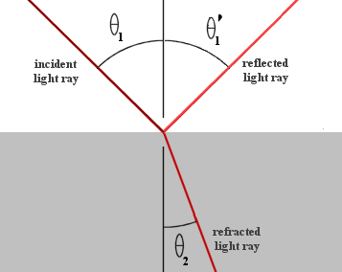
Mathematical explanation surface plasmon-polariton
$$H_{y1}=Ae^{−j(k_{z1}z+k_{x1}x)}+Be^{j(k_{z1}z−k_{x1}x)}$$
$E_{x1}=−\frac{1}{jωε_{1}}\frac{∂H_{y1}}{∂z}=\frac{k_{z1}}{ωε_{1}}\left[Ae^{−j\left(k_{z1}z+k_{x1}x\right)}+Be^{j\left(k_{z1}z−k_{x1}x\right)}\right]$

Slide 5
Mathematical explanation surface plasmon-polariton
$$H_{y2}=Ce^{−j(k_{z2}z+k_{x2}x)}$$
$$E_{x2}=\frac{k_{z2}}{ω2}e^{−j(k_{z2}z+k_{x2}x)}$$

Slide 6
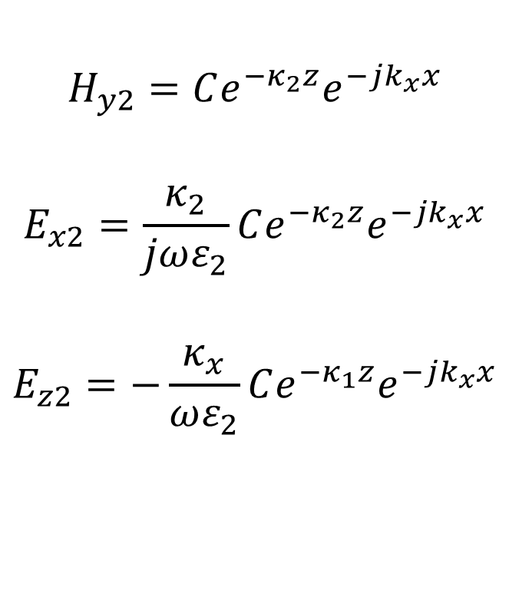
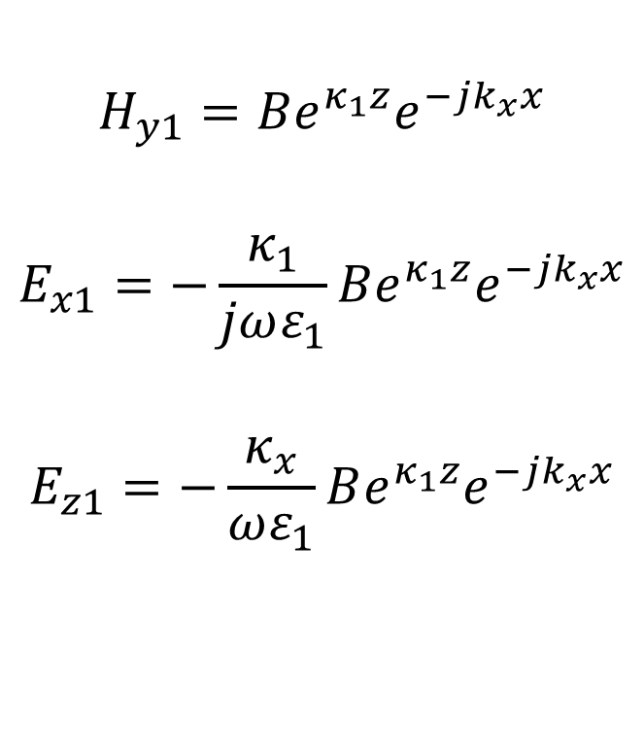
Mathematical explanation surface plasmon-polariton
Medium 1
Medium 2
$$H_{y1}=Be^{κ_{1}z}e^{−jk_{x}x}$$
$$E_{x1}=−\frac{κ_{1}}{jωε_{1}}Be^{κ_{1}z}e^{−jk_{x}x}$$
$$E_{z1}=−\frac{κ_{x}}{ωε_{1}}Be^{κ_{1}z}e^{−jk_{x}x}$$
$$H_{y2}=Ce^{−κ_{2}z}e^{−jk_{x}x}$$
$$E_{x2}=\frac{κ_{2}}{jωε_{2}}Ce^{−κ_{2}z}e^{−jk_{x}x}$$
$$E_{z2}=−\frac{κ_{x}}{ωε_{2}}Ce^{−κ_{1}z}e^{−jk_{x}x}$$

Slide 7

Mathematical explanation surface plasmon-polariton
$$⇒B=C ⇒−\frac{κ_{1}}{ε_{1}}=\frac{κ_{2}}{ε_{2}}$$
$$k_{x}=\frac{ω}{c}{\left(\frac{ε_{1}ε_{2}}{ε_{1}+ε_{2}}\right)}^{\frac{1}{2}}$$

Slide 8
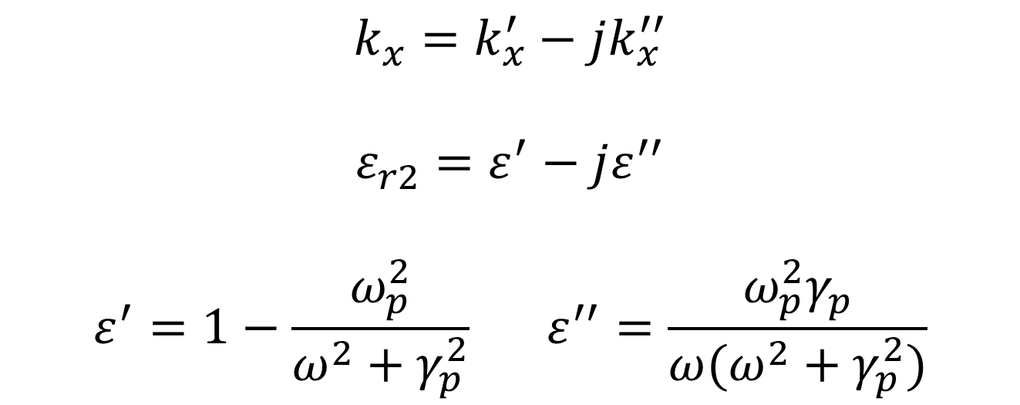
Mathematical explanation SPP losses
$$k_{x}=k_{x}^{′}−jk_{x}^{′′}$$
$$ε_{r2}=ε^{′}−jε^{′′}$$
$$ε^{′}=1−\frac{ω_{p}^{2}}{ω^{2}+γ_{p}^{2}} ε^{′′}=\frac{ω_{p}^{2}γ_{p}}{ω(ω^{2}+γ_{p}^{2})}$$

Slide 9
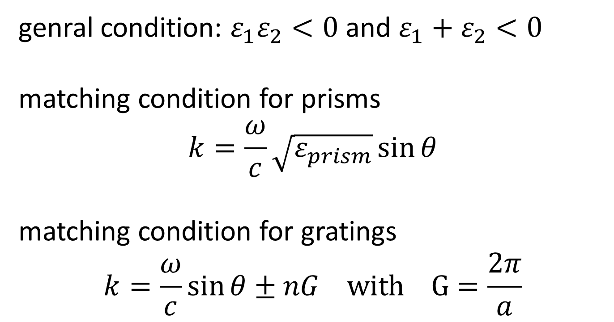
Mathematical explanation excitation conditions
genral condition: $ε_{1}ε_{2}<0$ and $ε_{1}+ε_{2}<0$
matching condition for prisms
$$k=\frac{ω}{c}\sqrt{ε_{prism}}\sin{θ}$$
matching condition for gratings
$$k=\frac{ω}{c}\sin{θ}±nG with G=\frac{2π}{a}$$

Slide 10
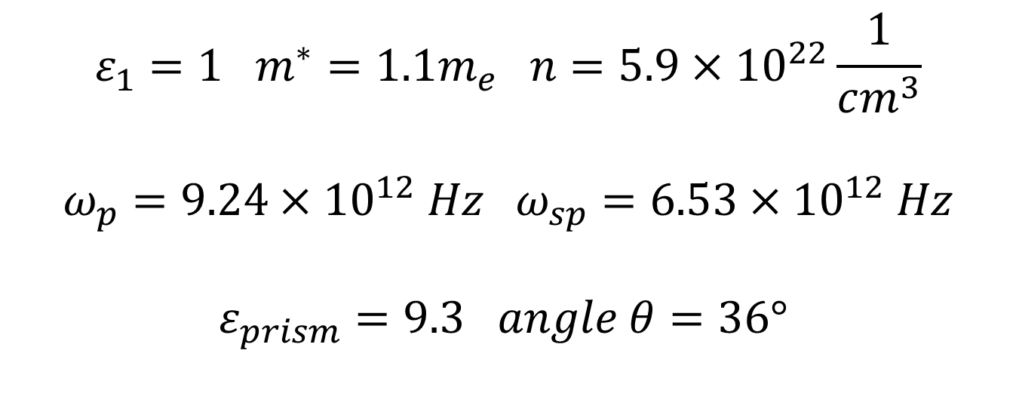
SPP matching
Example: air, gold and sapphire prism
$$ε_{1}=1 m^{∗}=1.1m_{e} n=5.9×{10}^{22}\frac{1}{cm^{3}}$$
$$ω_{p}=9.24×{10}^{12} Hz ω_{sp}=6.53×{10}^{12} Hz$$
$$ε_{prism}=9.3 angle θ=36°$$

Slide 11
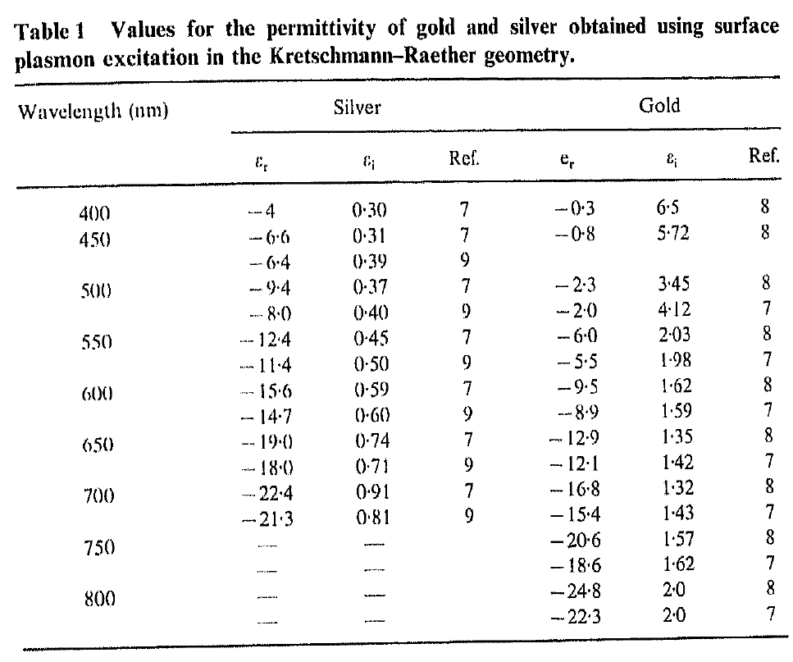
SPP matching
J.R. Sambles et.al. “Optical excitation of surface plasmons: an introduction”

Slide 12
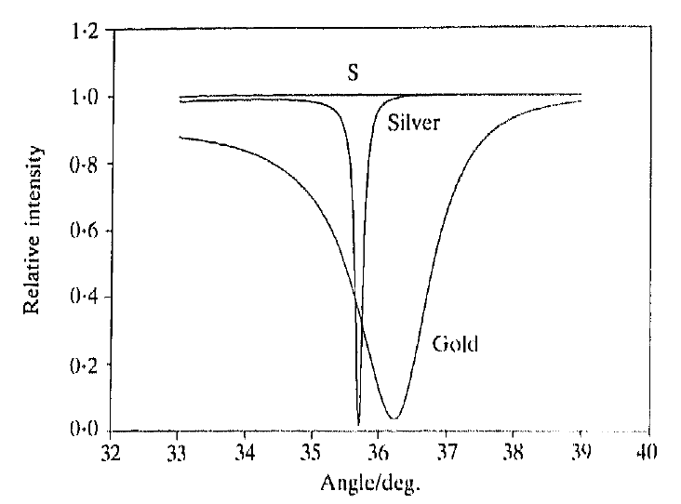
SPP matching
J.R. Sambles et.al. “Optical excitation of surface plasmons: an introduction”

Slide 13
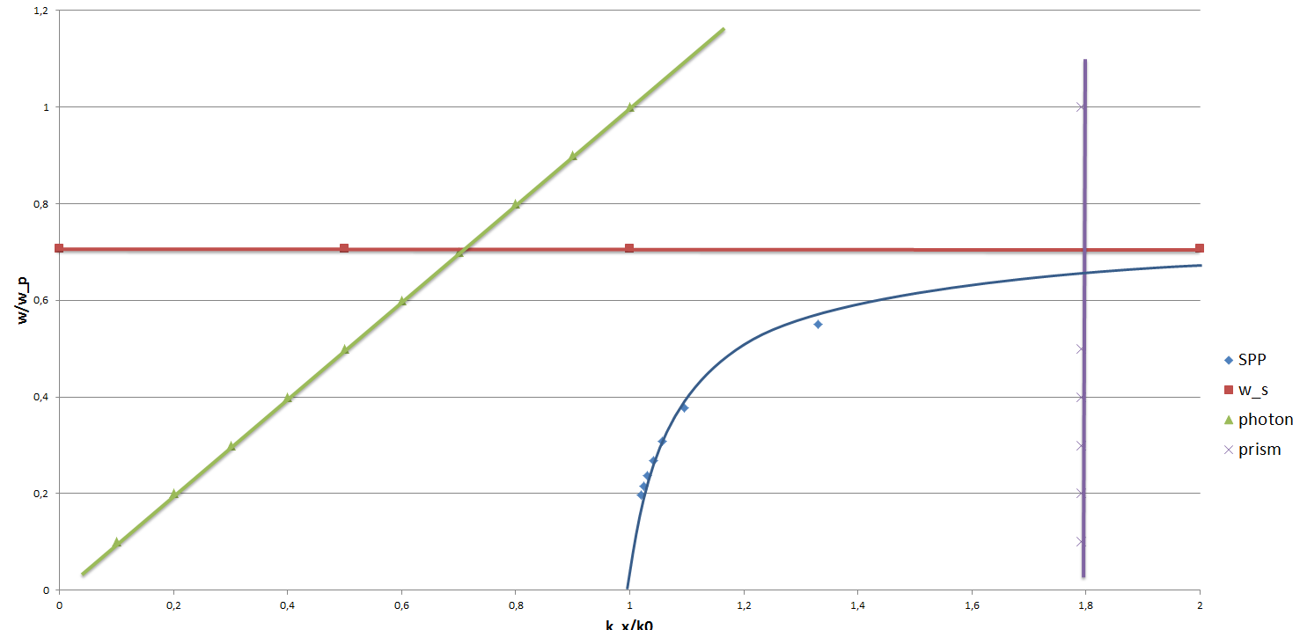
SPP matching

