Slide 1
Nanoplasmonic structures: Designing electromagnetic fields
Benji Börner

Slide 2
Content
short revision
Surface Plasmon Polariton (SPP) mathematical
SPP excitation by electons
SPP excitation by photons
nanoplasmonic structures
experimental applications

Slide 3
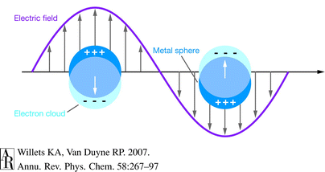
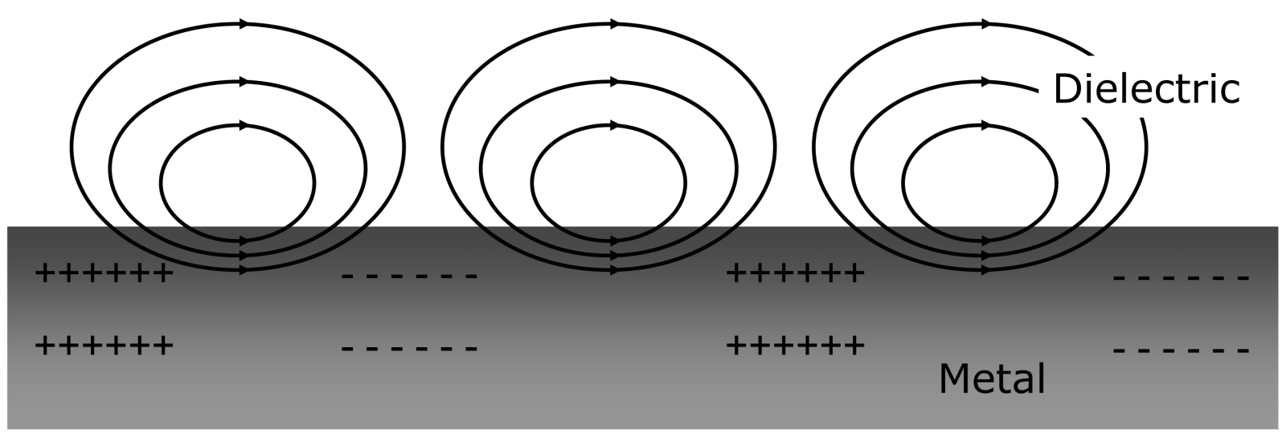
Revision
surface plasmons on metal surface
coherent oscillation of free electrons
can be excited by electrons and photons
www.ucd.ie

Slide 4
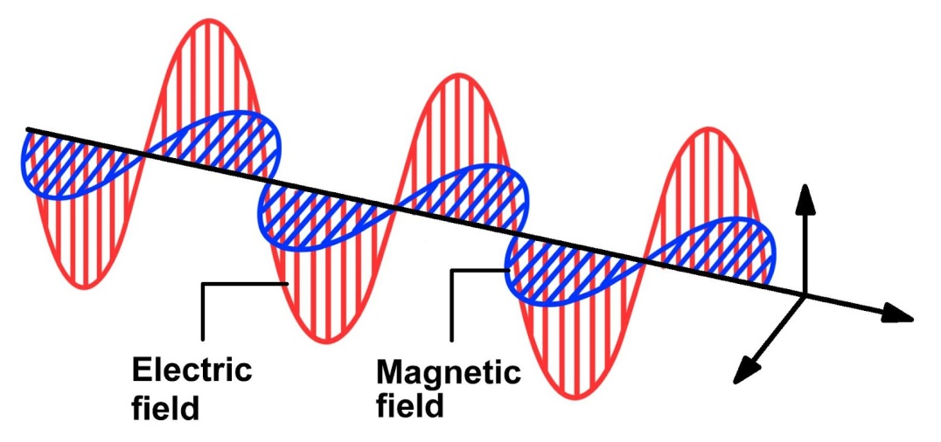
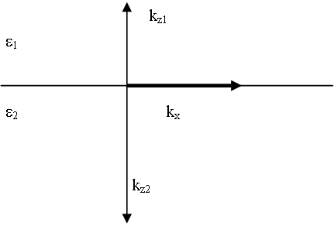

mathematical explanation – dispersion relation
$$E=E_{0}e^{[i\left(k_{x}x+k_{z}z−ωt\right)]}$$
boundary condition by Maxwell for em wave
$$\frac{k_{z1}}{ε_{1}}+\frac{k_{z2}}{ε_{2}}=0$$
$$k_{x}^{2}+k_{zi}^{2}=ε_{i}{\left(\frac{ω}{c}\right)}^{2} i=1,2$$
mysite.du.edu/~lconyers/SERDP/Figure5.htm

Slide 5

mathematical explanation – dispersion relation
$$k_{x}=\frac{ω}{c}{\left(\frac{ε_{1}ε_{2}}{ε_{1}+ε_{2}}\right)}^{\frac{1}{2}}$$
$$ε\left(ω\right)=1−\frac{ω_{P}^{2}}{ω^{2}} with ω_{P}={\left(\frac{ne^{2}}{ε_{0}m^{∗}}\right)}^{\frac{1}{2}}$$

Slide 6
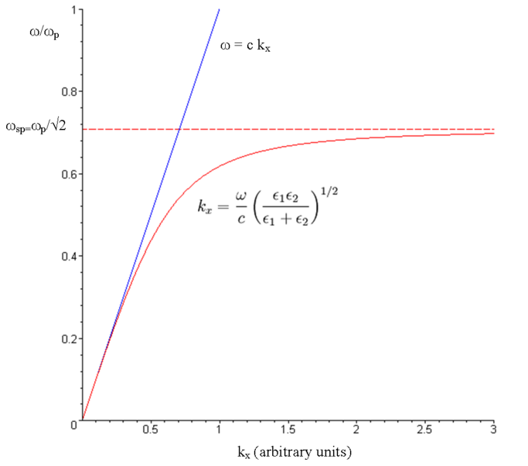
mathematical explanation – dispersion relation
real part
imaginary part

Slide 7

mathematical explanation – dispersion relation
damping due to ohmic losses and electron-core interactions
manifestation in imaginary part of dielectric function
$k_{x}=\dot{k_{x}}+i\ddot{k_{x}}=\left[\frac{ω}{c}{\left(\frac{\dot{ε_{1}}ε_{2}}{\dot{ε_{1}}+ε_{2}}\right)}^{\frac{1}{2}}\right]+i\left[\frac{ω}{c}{\left(\frac{\dot{ε_{1}}ε_{2}}{\dot{ε_{1}}+ε_{2}}\right)}^{\frac{3}{2}}\frac{\ddot{ε_{1}}}{2{\left(\dot{ε_{1}}\right)}^{2}}\right]$

Slide 8
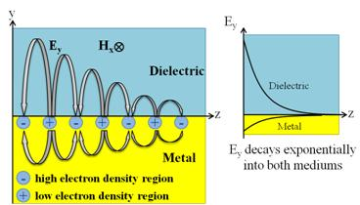
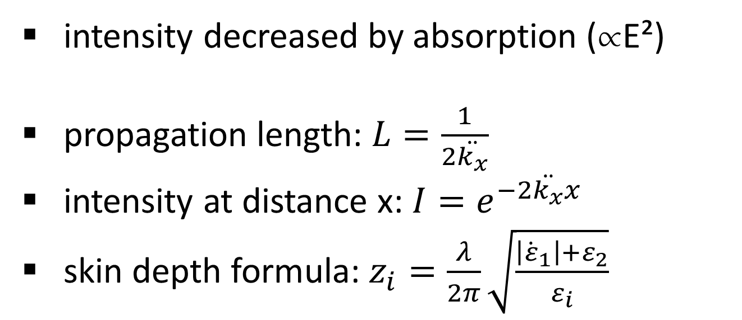
mathematical explanation
intensity decreased by absorption (E²)
propagation length: $L=\frac{1}{2\ddot{k_{x}}}$
intensity at distance x: $I=e^{−2\ddot{k_{x}}x}$
skin depth formula: $z_{i}=\frac{λ}{2π}\sqrt{\frac{\left|{\dot{ε}}_{1}\right|+ε_{2}}{ε_{i}}}$
http://erbium.ece.mcgill.ca/research/plasmonic-interconnects/

Slide 9
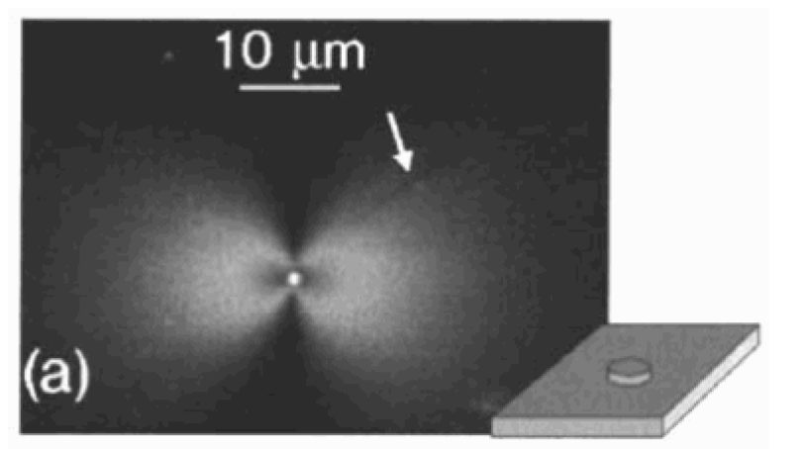
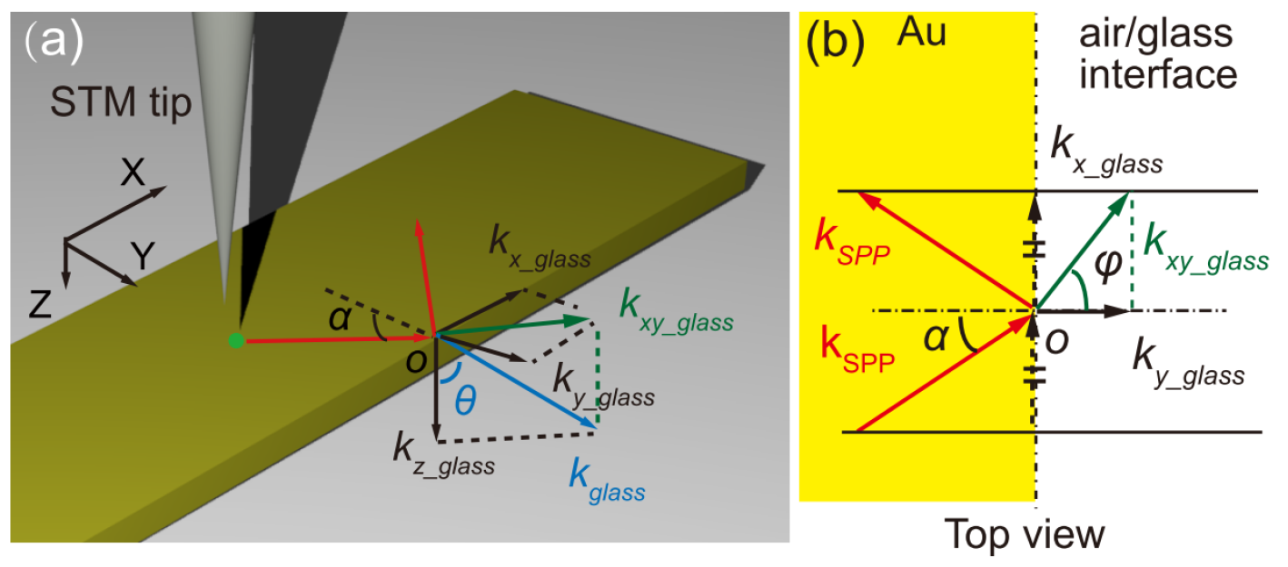
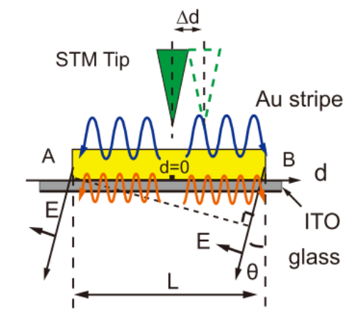
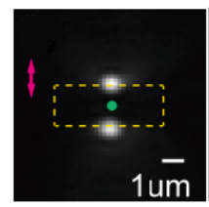
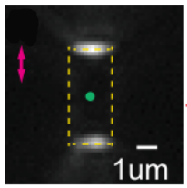
SPP excitation by electrons
electron scattering on surface
parallel part creates surface plasmon polariton
Yang Zhang et.al. “Edge scattering of surface plasmons excited by scanning tunneling microscopy”, Maier - Plasmonics

Slide 10
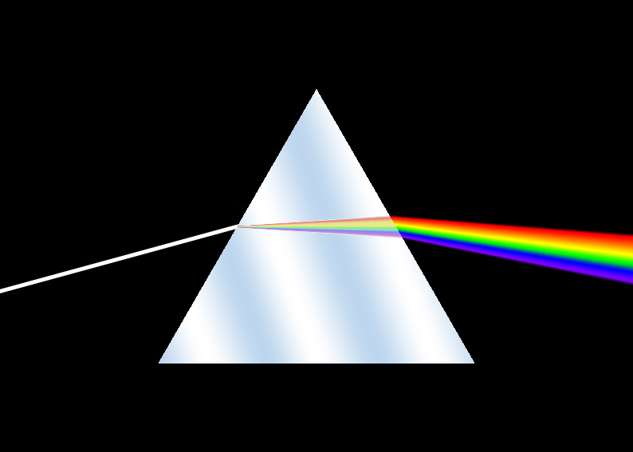
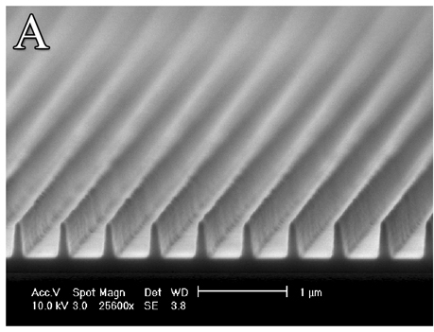
SPP excitation by photons
need to match wavelength and momentum
tools like prisms or gratings needed
http://pjmedia.com/lifestyle/files/2013/07/Dispersion_prism.jpg

Slide 11
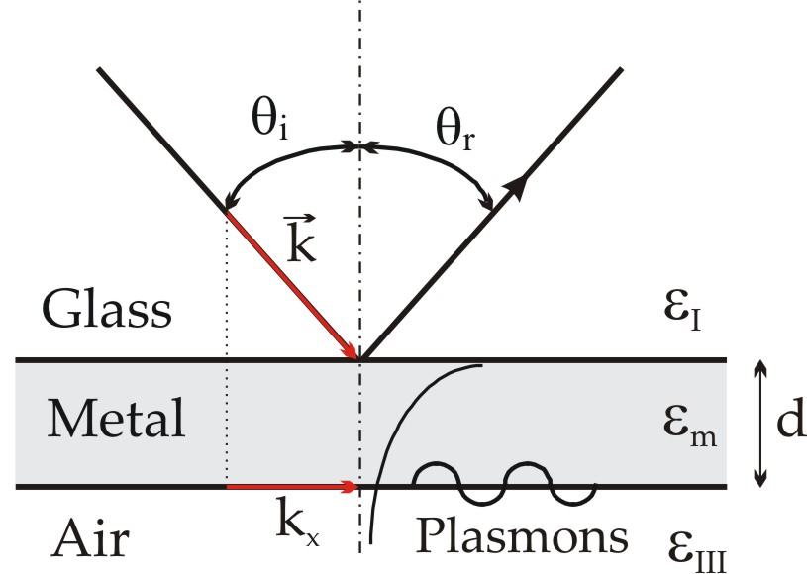
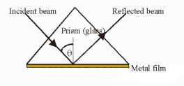
SPP excitation by photons - prism
prism in Kretschmann configuration
different dielectric functions match momentum
evanescent wave excites SPP
Google.de -> Kretschmann configuration

Slide 12
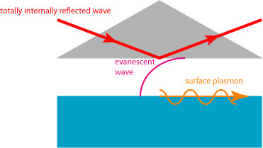
SPP excitation by photons - prism
prism in Otto configuration
SPP excited on top of metal film
http://skullsinthestars.com/2010/09/21/optics-basics-surface-plasmons/
Minghui Hong et.al „ Maskless multibeam laser irradiation enables large-area nanostructure fabrication“

Slide 13
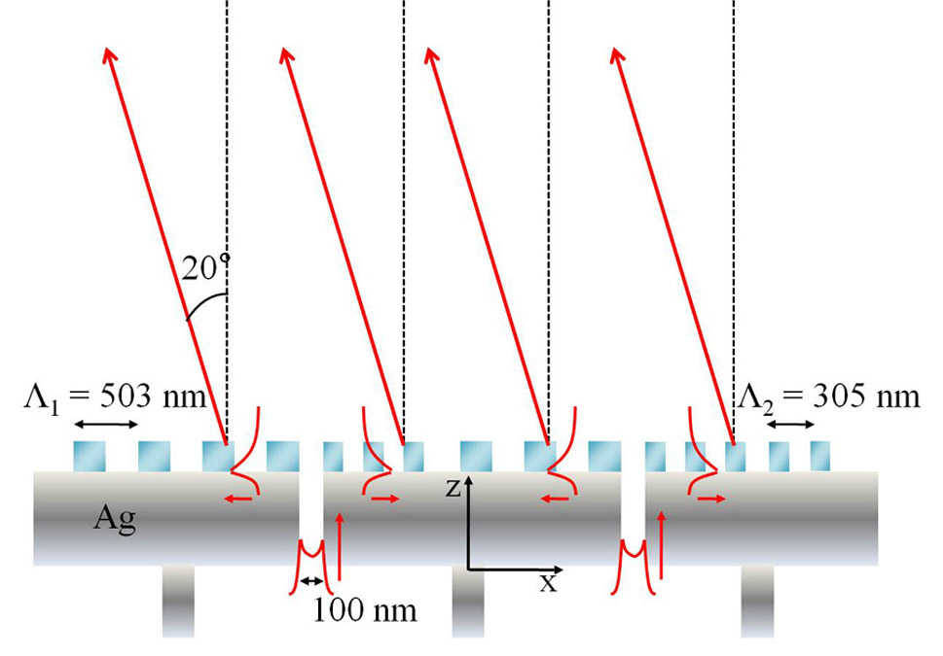
SPP excitation by photons - grating
excitation with grating
reciprocal grating vector gives imaginary part
Byoungho Lee et.al. „Shaping and focusing light beams with plasmonics”

Slide 14
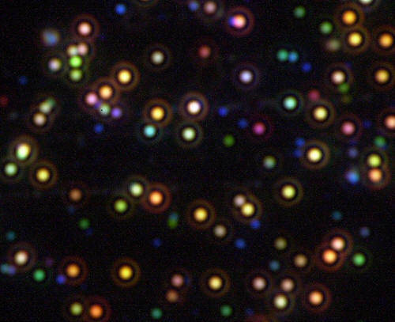
SPP excitation
SPP scatter on defects
defects provide free space radiation
http://www.westga.edu/~chem/facultydocs/stuart.htm

Slide 15
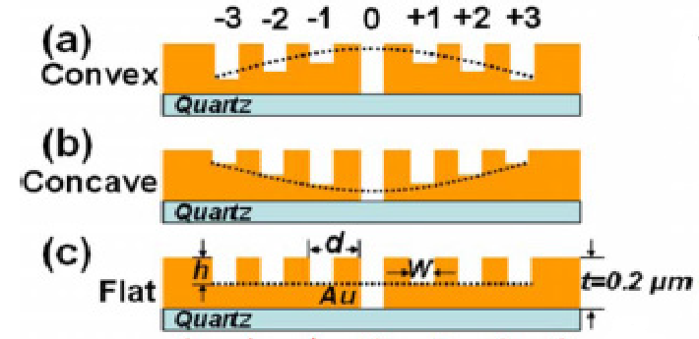
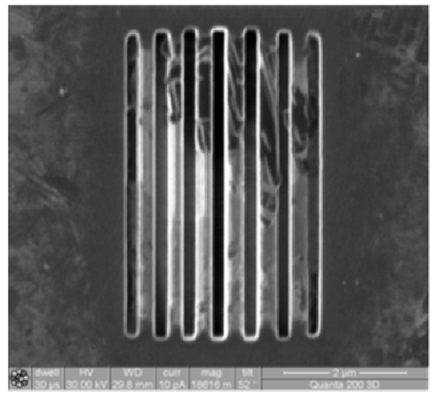
nanoplasmonic structures – gratings
Yongqi Fu et. al. “Plasmonic Lenses”

Slide 16
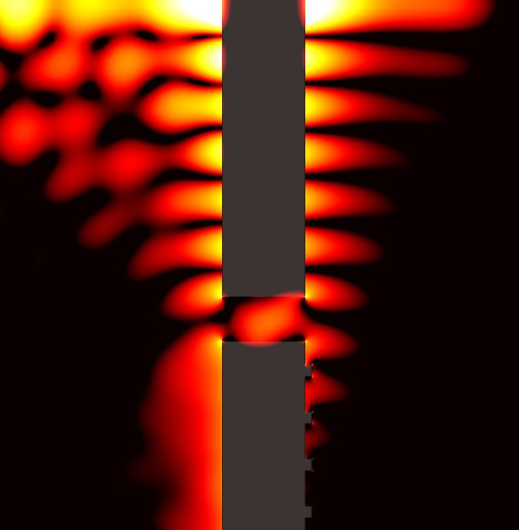
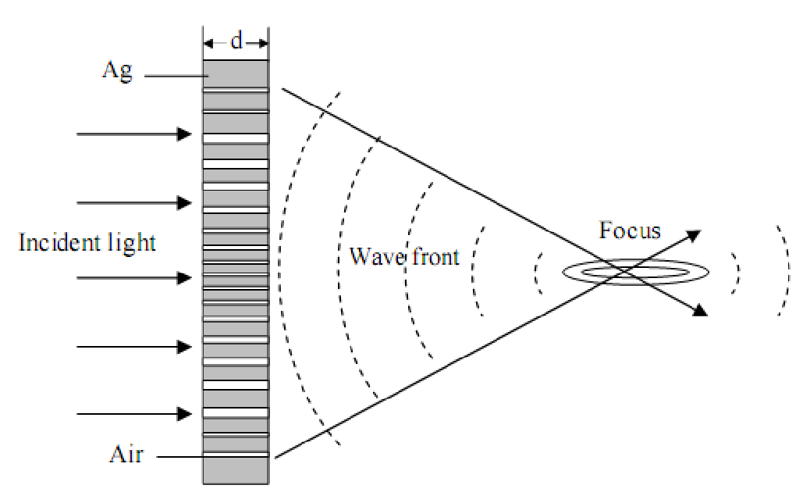
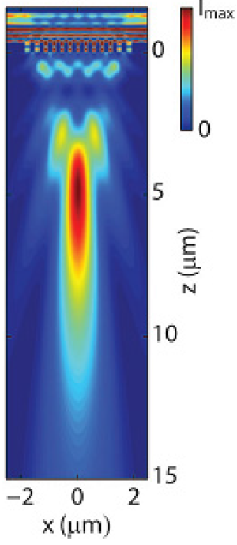
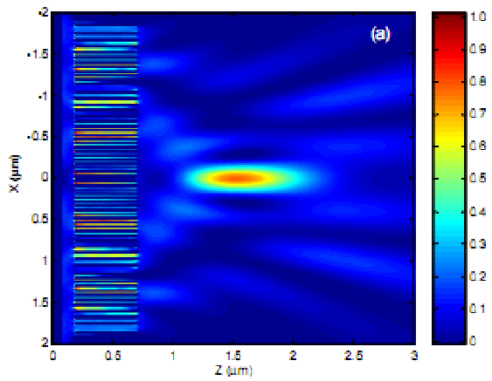
nanoplasmonic structures – flat gratings
http://www.cs.huji.ac.il/~ulevy/facil.php

Slide 17
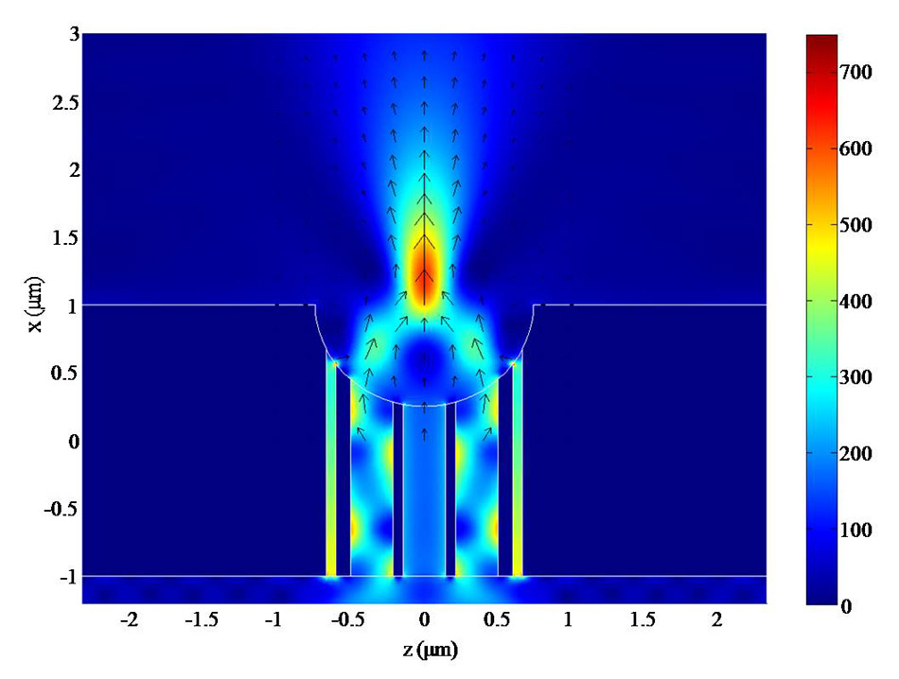
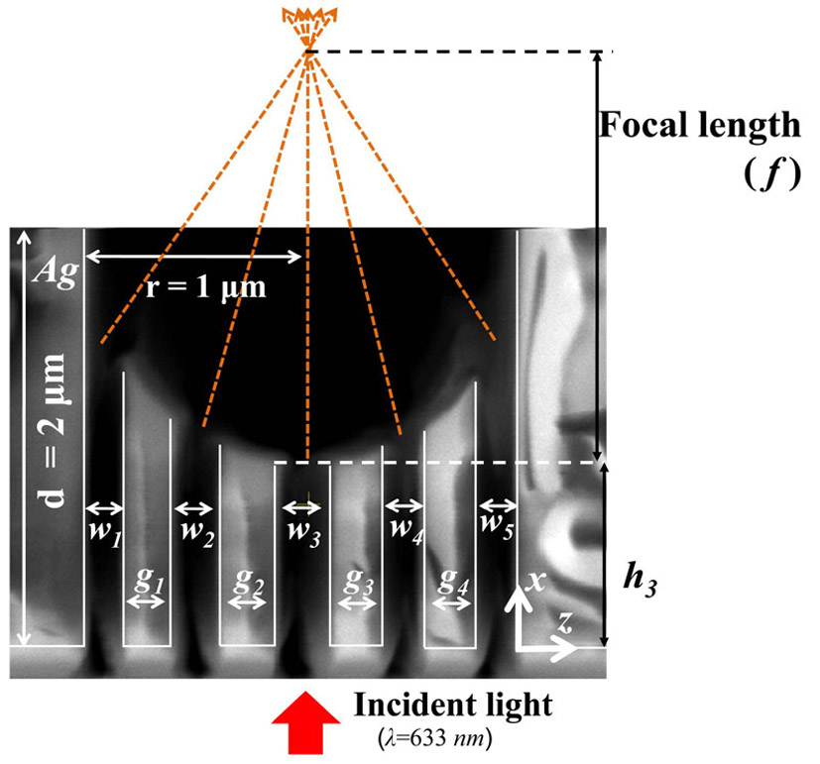
nanoplasmonic structures – concave gratings
Byoungho Lee et.al. „Shaping and focusing light beams with plasmonics“

Slide 18
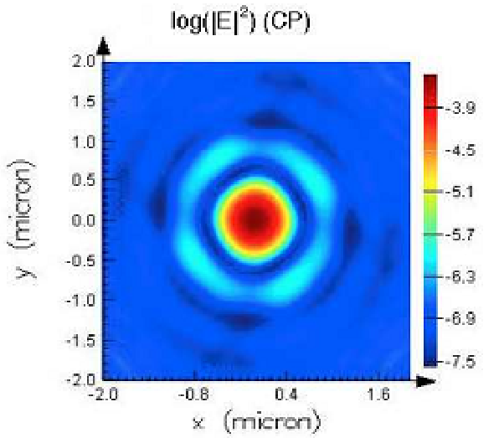
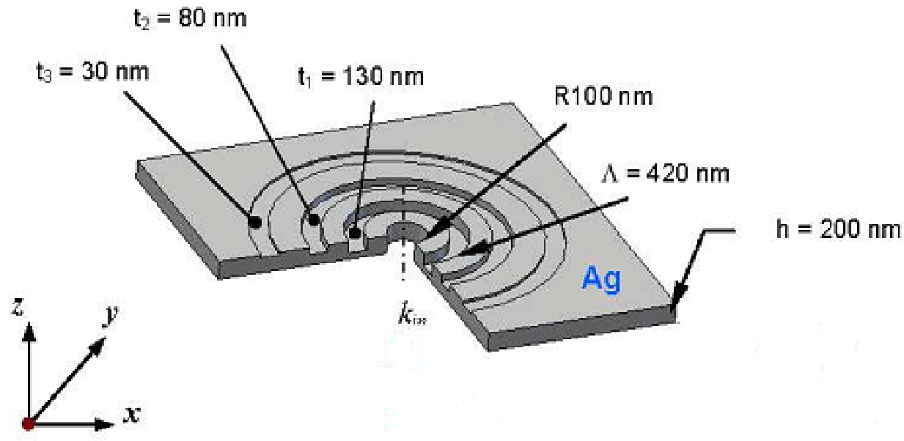
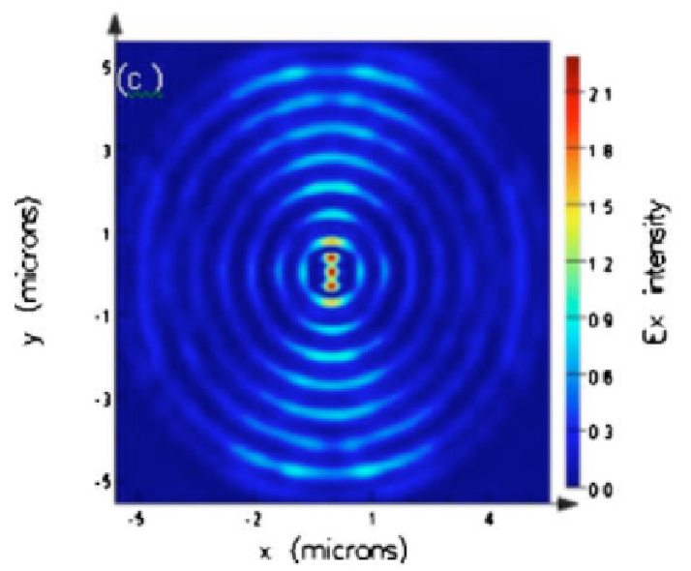
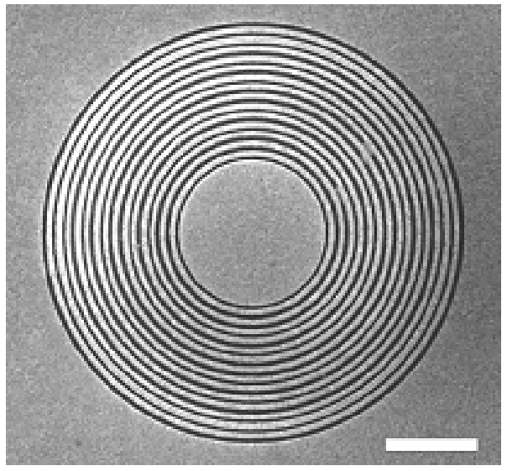
nanoplasmonic structures – concentric gratings
Yongqi Fu et. al. “Plasmonic Lenses”

Slide 19
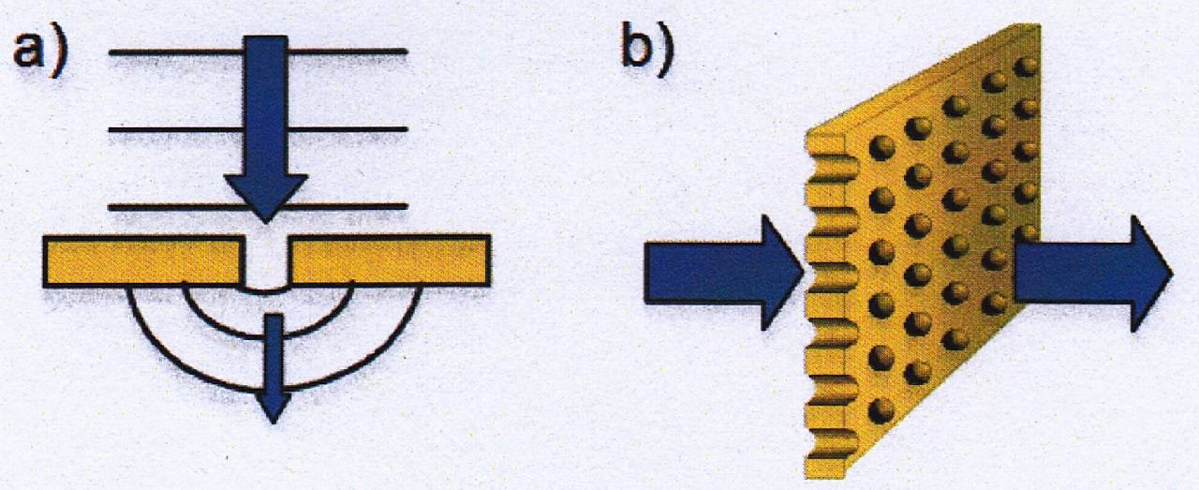
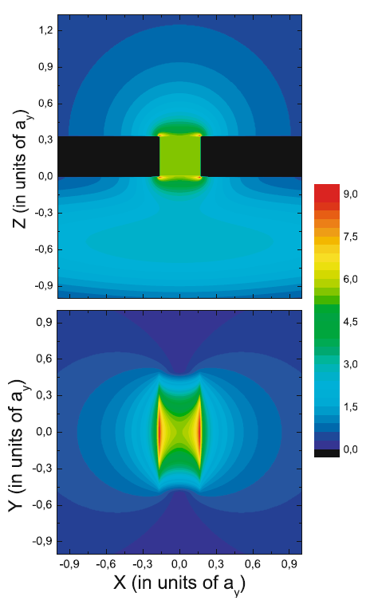
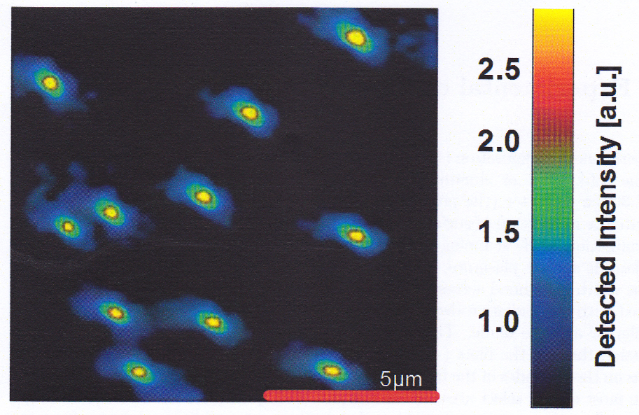
nanoplasmonic structures – nanoholes
Carsten Sönnichsen “Plasmons in metal nanostructures”
Maier - Plasmonics

Slide 20
experimental applications
investigation of surfaces to find defects
identify density changes
molecular detectors

Slide 21
Thank you!

