Slide 1
Surface-Enhanced Raman Scattering (SERS)
Christopher Winta

Slide 2
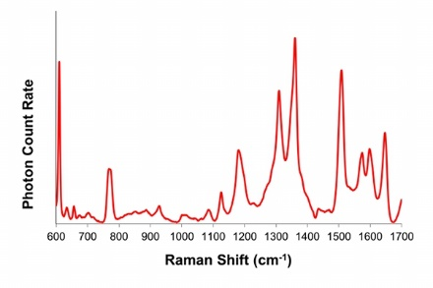
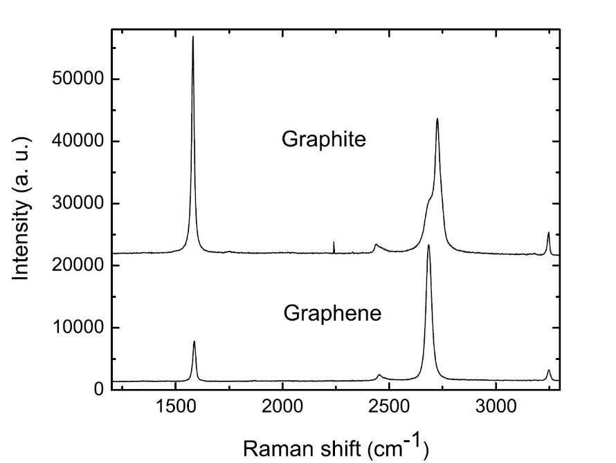
1 Introduction
SERS offers an improvement over normal Raman scattering in terms of sensitivity
gives Raman enhancements of up to 10⁶

Slide 3
1 Introduction
1974: initially observed by M. Fleischmann et al. [1]
1977: Jeanmaire and Van Duyne: Enhancement can‘t be solely due to increased surface area
1978: M. Moskovits proposes electromagnetic theory

Slide 4
2 Theory
Roughness, periodic structure ⇒ resonance frequency
Model roughness features with a sphere

Slide 5
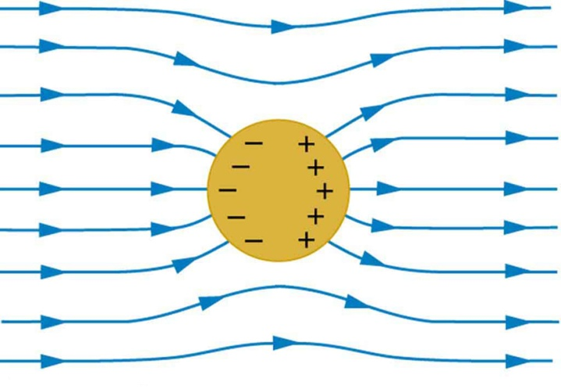
2 Theory
$$E_{r}=E_{0}∙\cos{θ}+g \left(\frac{a^{3}}{r^{3}}\right){ E}_{0}∙\cos{θ}$$
with $g=\frac{ε_{1}\left(ν_{L}\right)−ε_{0}}{ε_{1}\left(ν_{L}\right)+2ε_{0}}$
[2]
Metal particle is surrounded by electric field with maximum at $ε_{1}=−2$ for $ε_{0}≈1$.
Enhancement of incident light $E_{Surface}=g∙E_{0}$

Slide 6
2 Theory
Raman scattered light: $E_{R}∝α_{R} E_{Surface}∝α_{R} g E_{0}$
gets enhanced by the surface plasmon: ⇒ $E_{SERS}∝α_{R} g g^{′}E_{0}$
Measurement of intensity $I∝{\left|E\right|}^{2}$: ⇒ $I_{SERS}∝{\left|α_{R}\right|}^{2} {\left|g\right|}^{4}{ I}_{0}$ for $g≈g′$
$g_{Au}≈30 ⇒ {\left|g_{Au}\right|}^{4}≈8∙{10}^{5}$

Slide 7
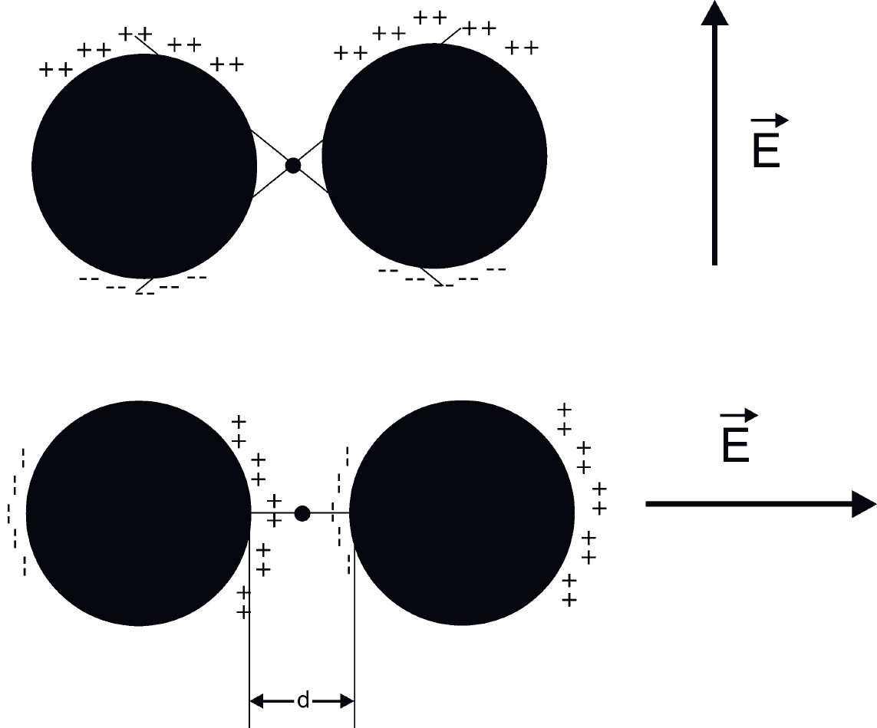
3 SERS in between particles
Electric field in between particles increases as the distance $d$ decreases.
[2]

Slide 8
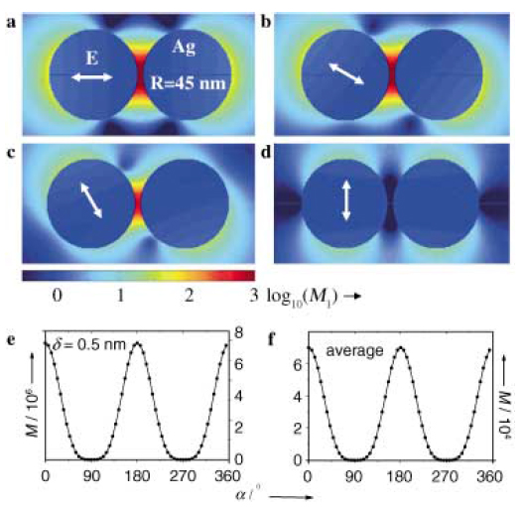
3 SERS in between particles
[3]

Slide 9
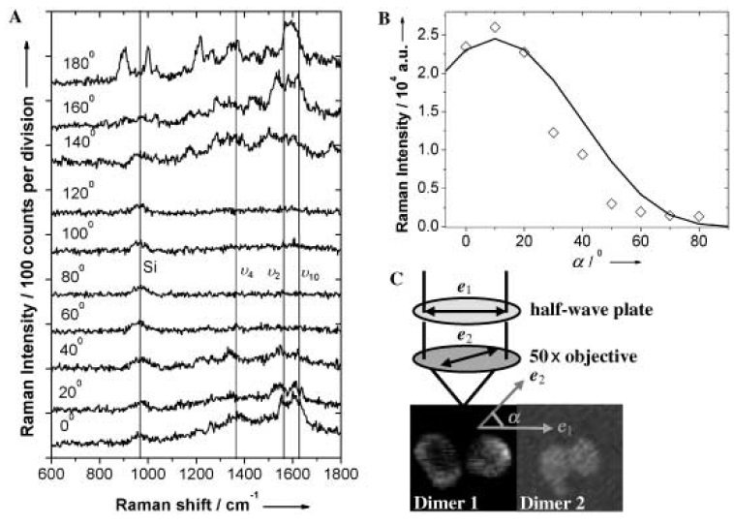
3 SERS in between particles
[3]

Slide 10
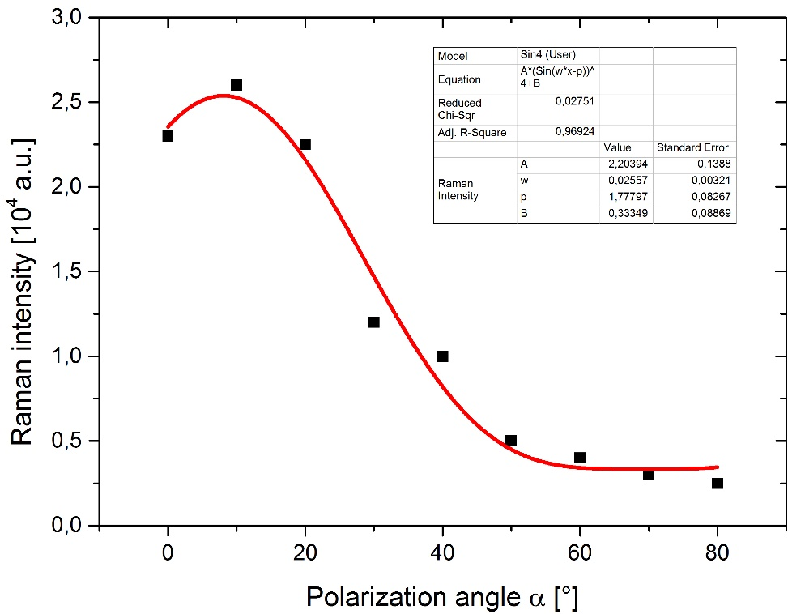
3 SERS in between particles
[3]

Slide 11
Thank you!

Slide 12
References
M. Fleischmann, P.J. Hendra, A.J. McQuillan, Raman spectra of pyridine adsorbed at a silver electrode, 1974
Katrin Kneipp, Martin Moskovits, Harald Kneipp: Surface-Enhanced Raman Scattering: a Brief Perspective, Springer, 2006
Hongxing Xu, Mikael Käll, Polarization-Dependent Surface-Enhanced Raman Spectroscopy of Isolated Silver Nanoaggregates, 2003

